Slide 1
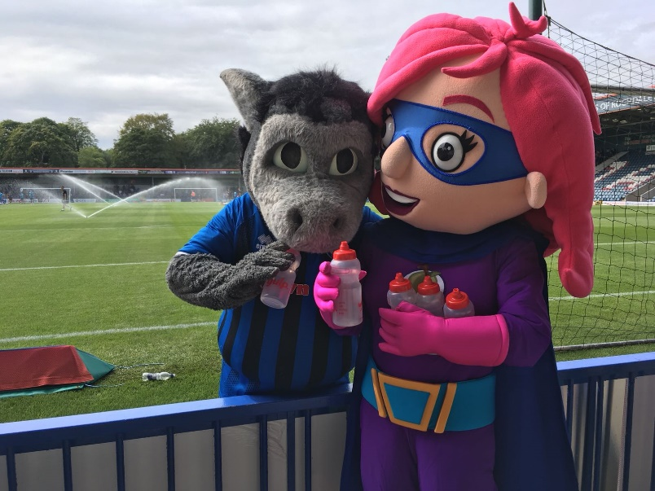
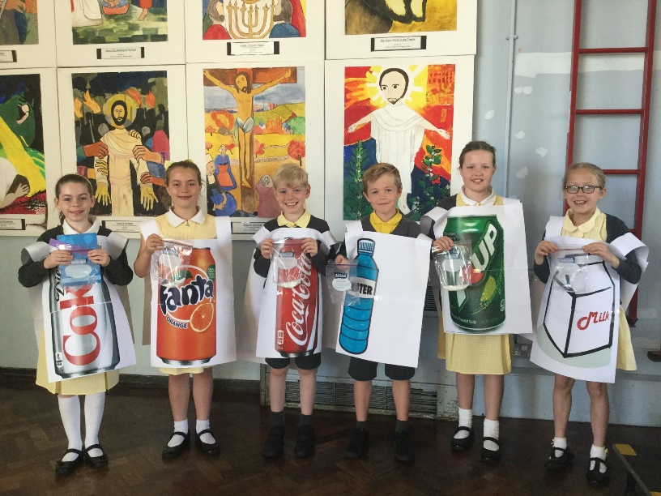
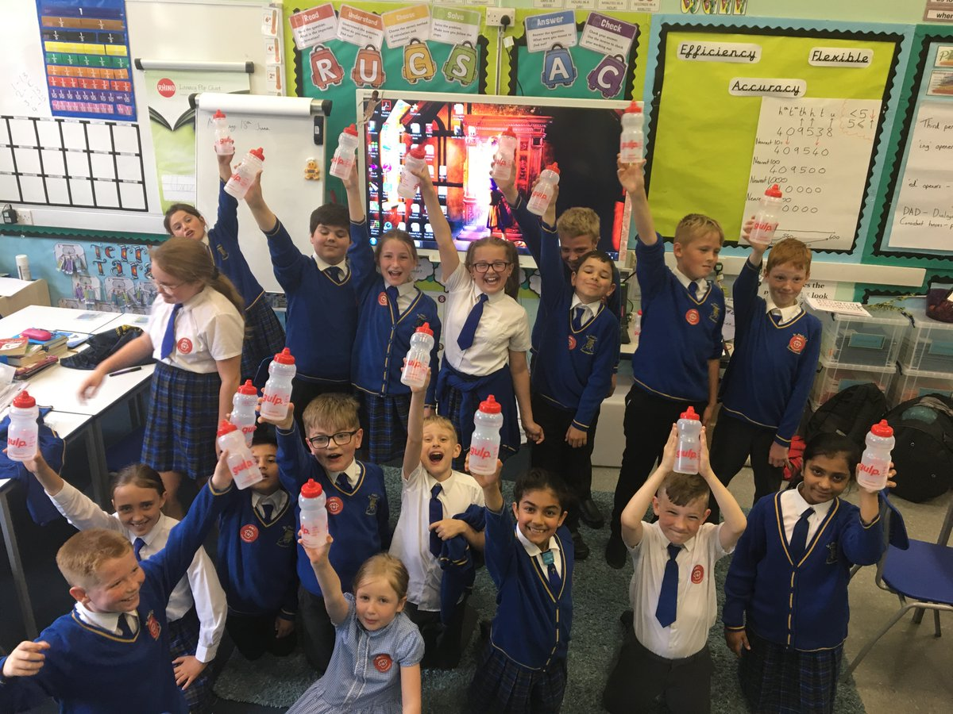
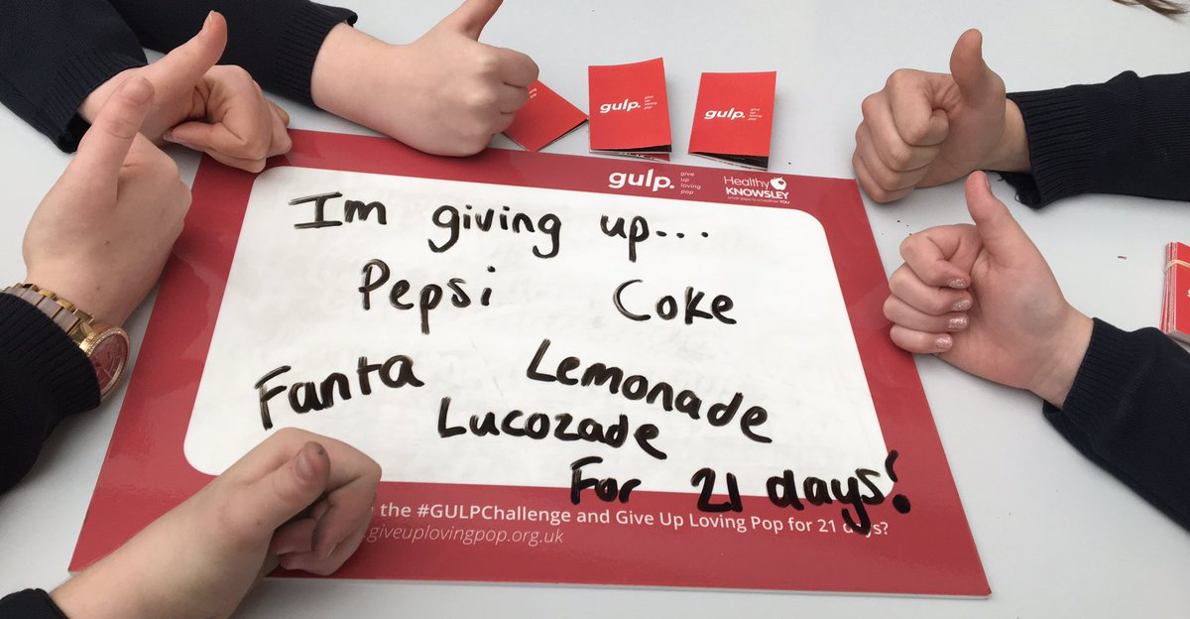
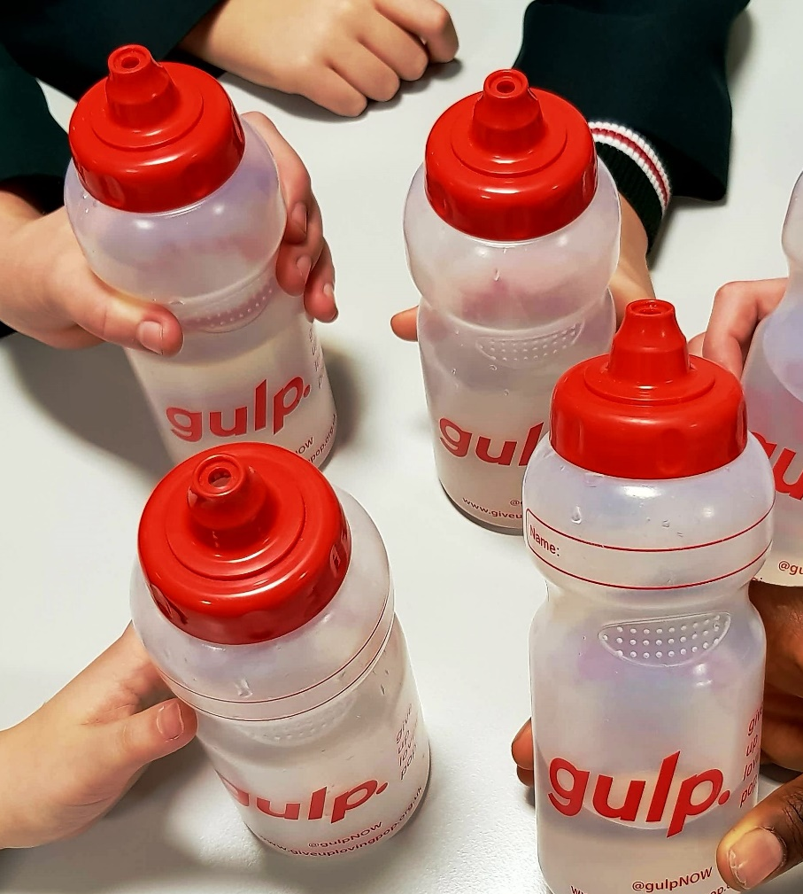
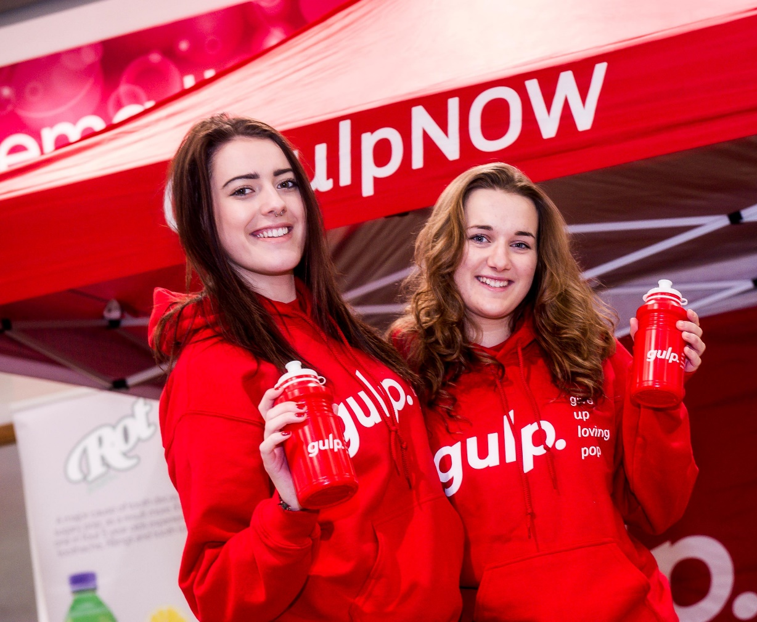
It’s time to Give Up Loving Pop!
KS2 Assembly
© Health Equalities Group 2023

Slide 2
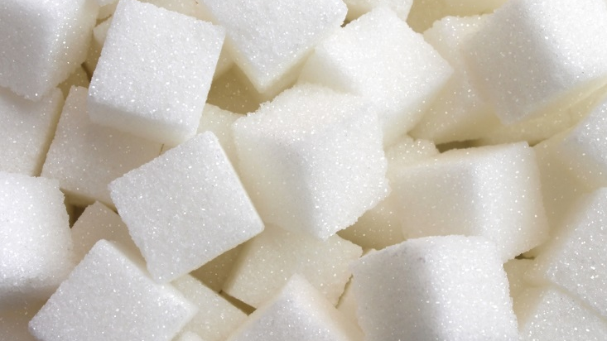
Can you name some food and drink items that contain lots of sugar?
Notes:
Ask the children to put their hand up if they can name a food or drink item which contains a lot of sugar. Possible answers include:
Sweets, ice cream, cakes, sweet pastries, biscuits, chocolate, ice lollies, sugary drinks. Also point out that sugar is hidden in savoury foods such as tomato sauce, ready meals and even bread.
A can of Coca-Cola contains 9tsp of sugar. Ask the children to remember this fact (for later in the presentation).

Slide 3
Hands up if you…
Drink sugary drinks every day?
Prefer sugary drinks to water?
Notes:
Thinking about sugary drinks, put your hands up if you drink sugary drinks every day.
Put your hand up if you prefer sugary drinks to water.
Image source: Canva

Slide 4
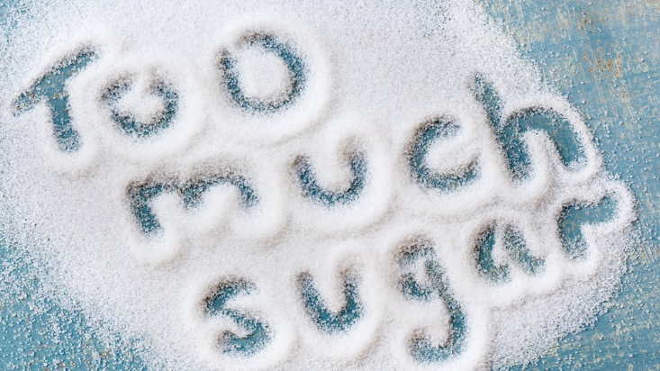
Notes:
Explain to the children that having too much sugar can cause problems for our teeth, but can also impact on our health in later life too.

Slide 5
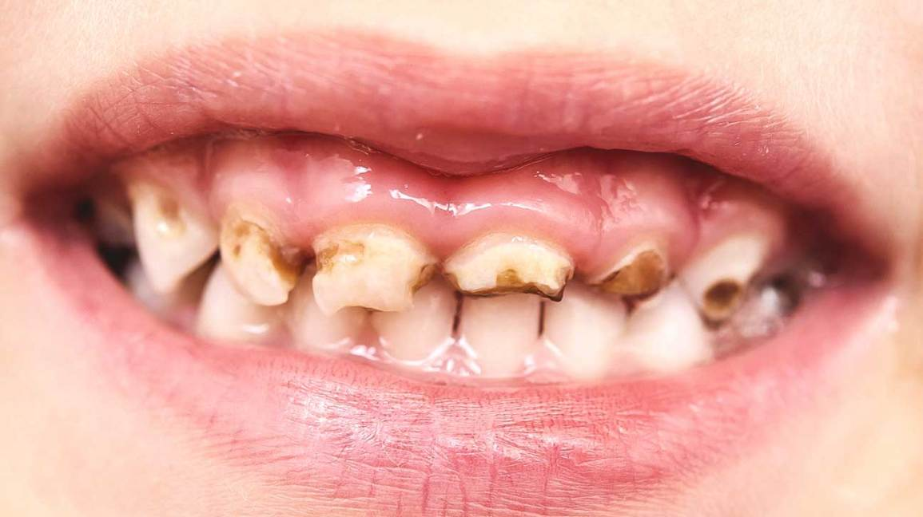
Notes:
Ask the children what they think of this picture. Explain that the brown bits on the teeth are decayed teeth, caused by eating too much sugar and not brushing teeth properly. Explain that in some serious cases, teeth have to be taken out because they have rotten and could cause harm to the gums.

Slide 6
7–11-year-olds
6 teaspoons a day (24g)
Notes:
Ask the 7–10-year-olds to guess how many teaspoons of sugar they should have per day - tell them they should have no more than 6 teaspoons of sugar per day. (One teaspoon = equals 4 grams sugar). Ask the children to count the number of teaspoons together out loud. (have some teaspoons out on tables to demonstrate/ or get children to count on fingers)
“Does this seem like a lot or a small amount of sugar?”
Ask the children “can you remember how many teaspoons of sugar there are in a can of Coca-Cola?” (If you need a reminder it is 9tsp).
Ask “how many cans of Coca-Cola could you have per day to stay within the maximum guidelines?” The answer is none. A can of Coca-Cola would take all of the children way over the maximum amount of sugar and this is without considering the sugar in the other food and drink you have during the day.

Slide 7
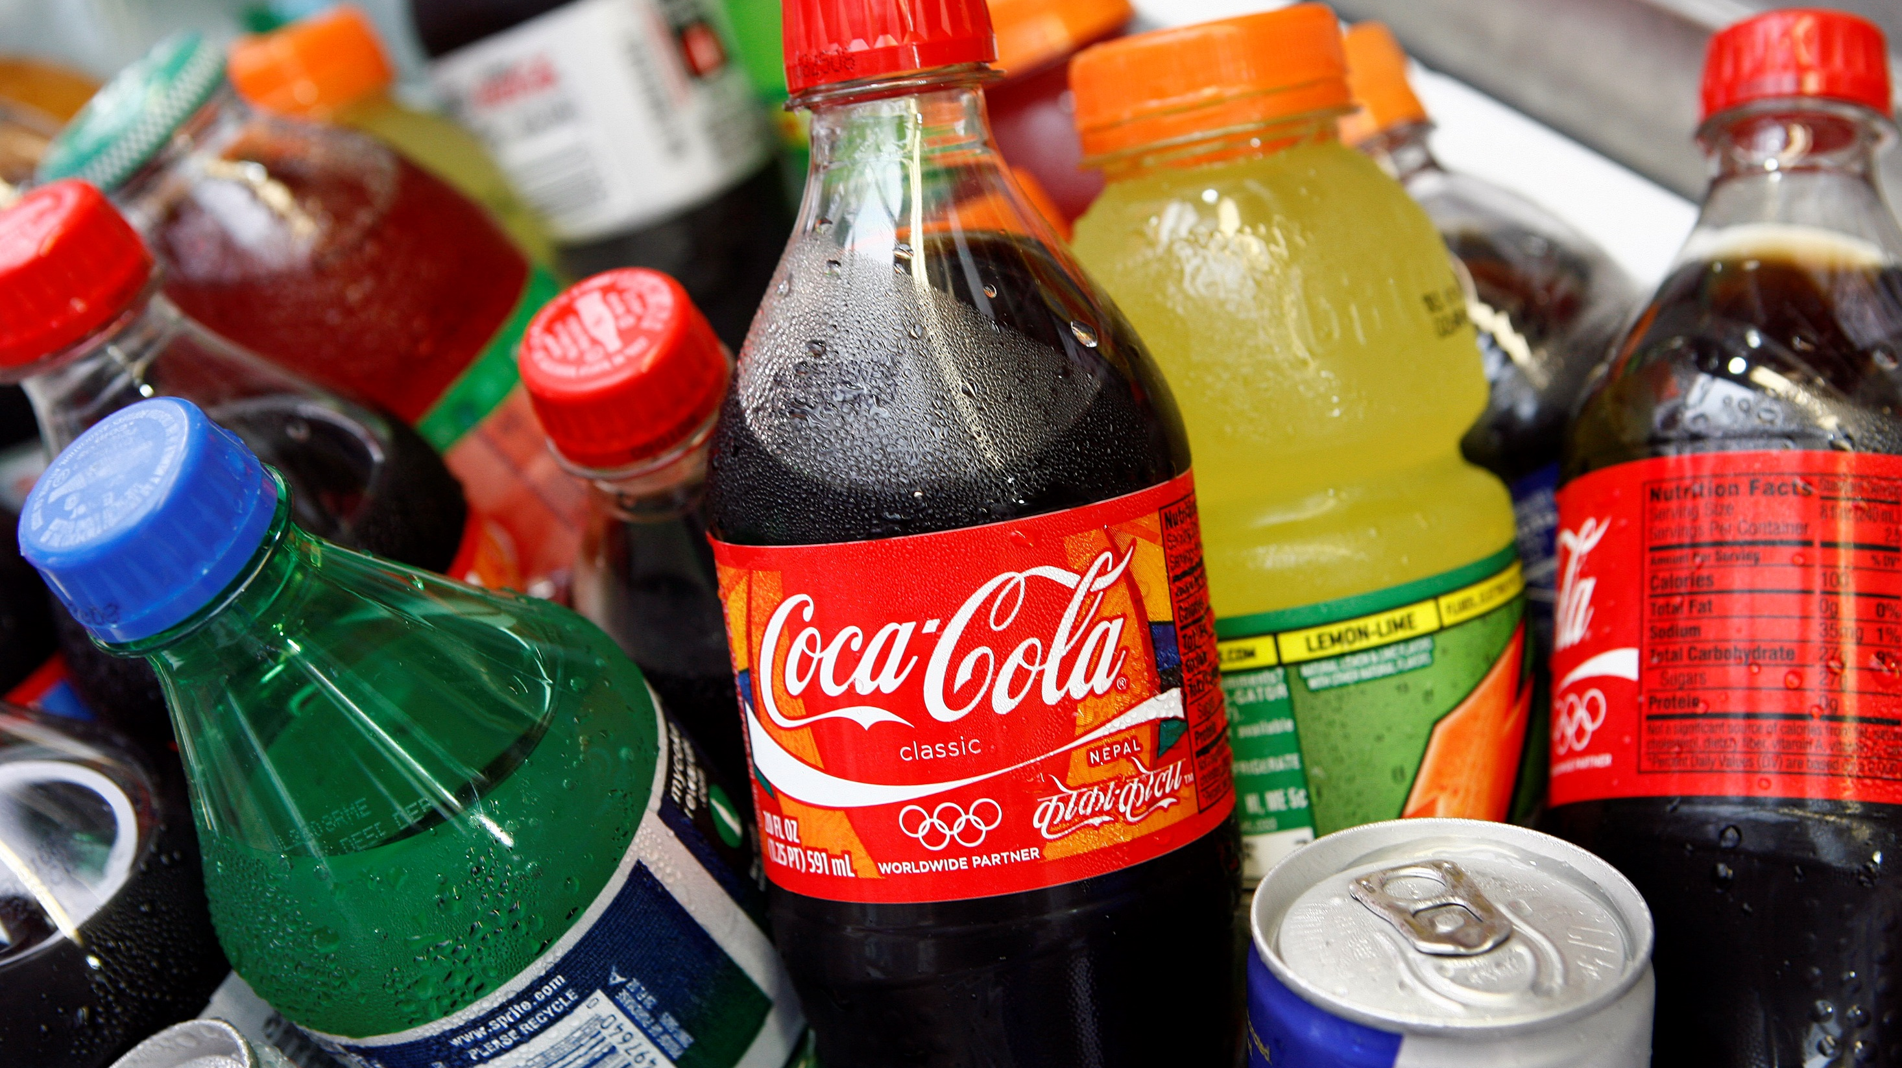
Let’s have a look at how much sugar is in some popular drinks
Re-think your Drink!
Notes:
Introduce the ‘Rethink your drink’ game. Ask the children if they remember how much sugar they should have as a maximum per day.
19g or 5 tsps. for children aged 4 to 6
24g or 6 tsps. for children aged 7 to 10
Then explain that you will show a number of different drinks, and the children need to put their hands up and guess how many teaspoons of sugar is in the drinks. Alternatively, each child can have a piece of paper (or work in pairs) and write down the number of teaspoons they think is in each drink and discuss at the end of the game.
This game will get them thinking and also get them moving!

Slide 8
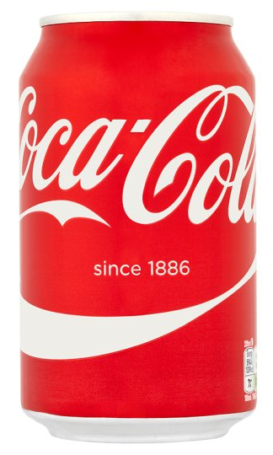
330ml
Notes:
Coca-Cola
Soft drink
Answer: 9 teaspoons of sugar

Slide 9
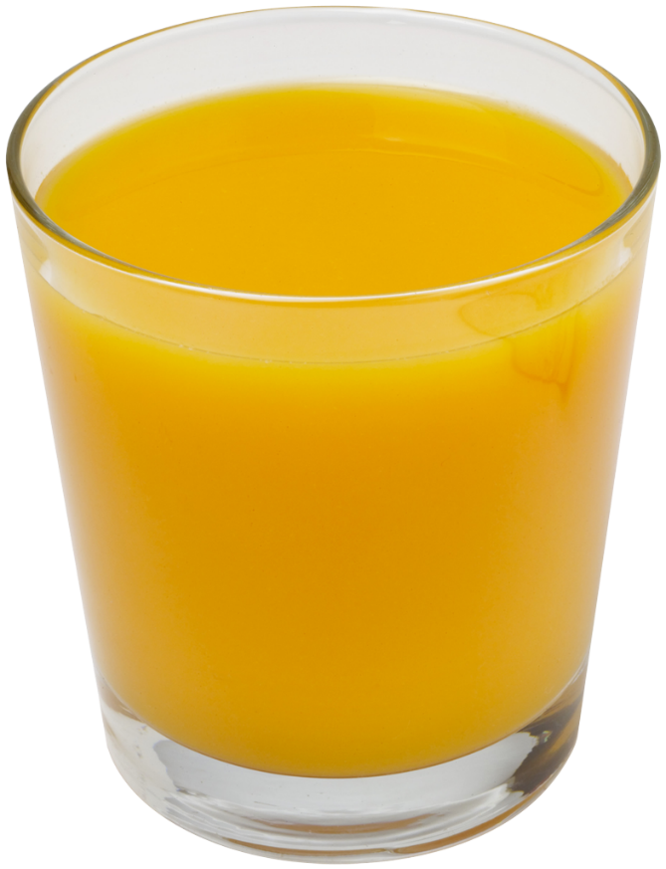
A glass of pure fruit juice counts towards your 5 a day but still contains a lot of sugar. Best to have orange juice during mealtimes.
200ml
Notes:
Pure orange juice
Fruit Juice
Answer: 5 teaspoons of sugar
A glass of pure fruit juice counts towards your 5 a day but still contains a lot of sugar. Best to have juice during mealtimes.

Slide 10
500ml
Notes:
Ribena Blackcurrant
Soft drink
Answer: Almost 6 teaspoons of sugar

Slide 11
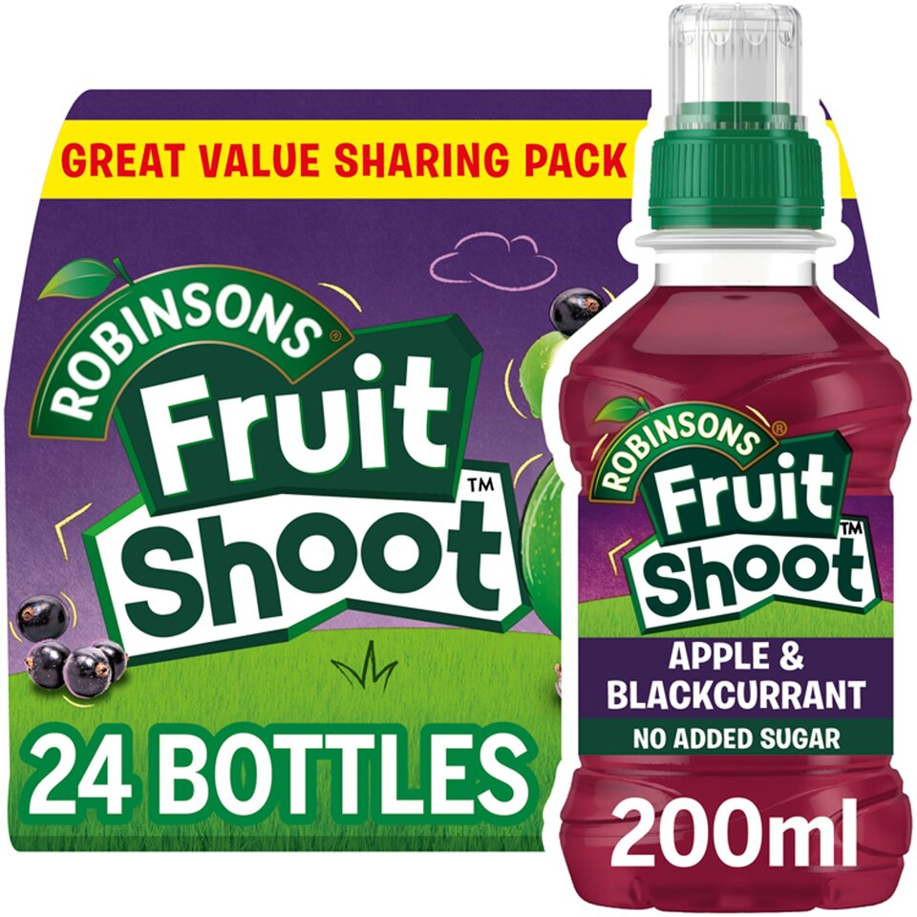
Although low in sugar, water and milk are still the best choices for healthy smiles!
Less than 1 teaspoon of sugar
200ml
Notes:
Robinsons fruit shoot – apple & blackcurrant
Fruit juice
Answer: Less than one teaspoon

Slide 12
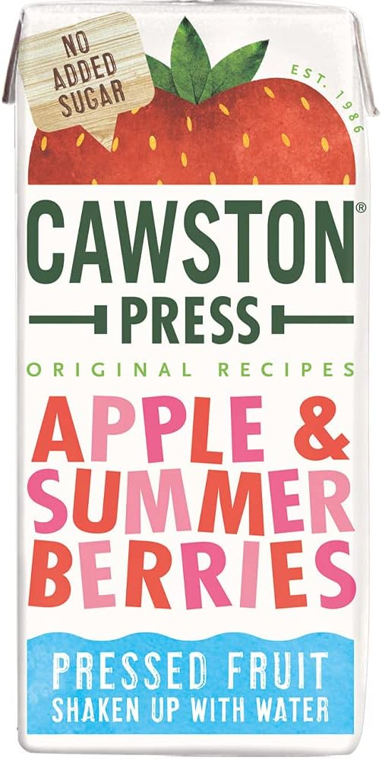
200ml
Notes:
Cawston Press – apple and summer berries
Fruit Juice
Answer: 3 teaspoons of sugar

Slide 13
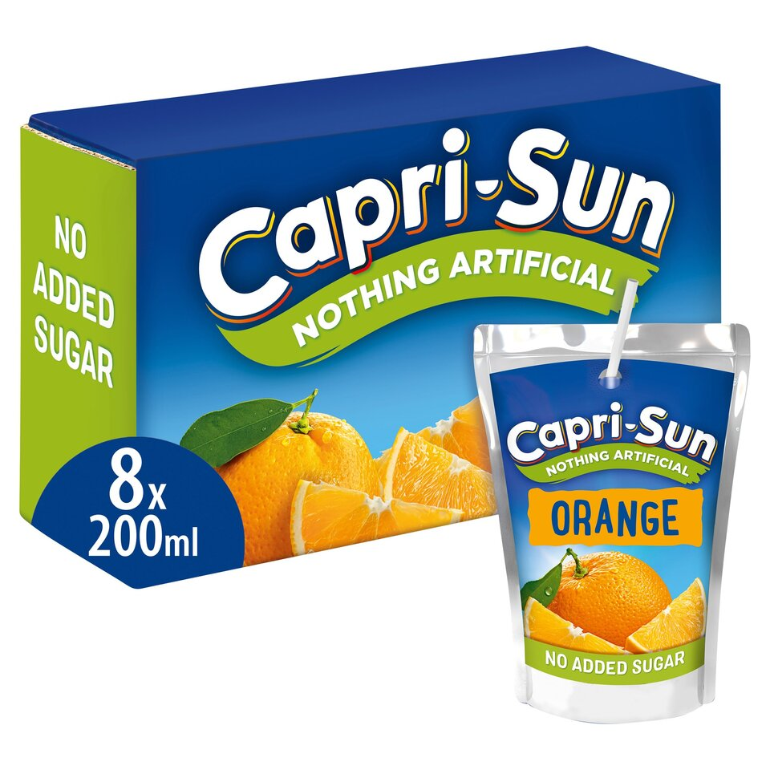
Although low in sugar, water and milk are still the best choices for healthy smiles!
Less than 1 teaspoon of sugar
200ml
Notes:
Capri Sun Orange – no added sugar
Answer: Less than 1 teaspoon of sugar
A glass of pure fruit juice counts towards your 5 a day but still contains a lot of sugar. Best to have juice during meal-times.

Slide 14
Milkshakes can have a lot of sugar in them – plain milk is best!
471ml
Notes:
Frijj Burst of Banana
Milkshake
Answer: Almost 10 teaspoons of sugar

Slide 15
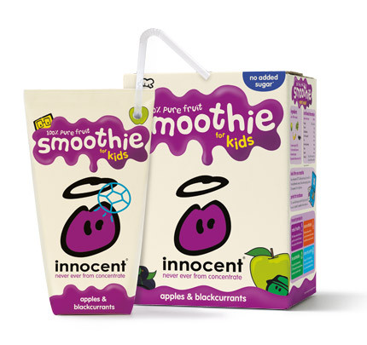
Although they contribute to your 5 a day (150ml glass), smoothies have lots of sugar in them!
180ml
Notes:
Innocent Smoothie Apples and Blackcurrant
Smoothie
Answer: 5 teaspoons of sugar

Slide 16
Milkshakes can have a lot of sugar in them – plain milk is best!
200ml
Notes:
Happy Monkey Milkshakes – Strawberry
Smoothie
Answer: 4 teaspoons of sugar

Slide 17
500ml
Notes:
Vimto
Soft drink
Answer: 8 teaspoons of sugar

Slide 18
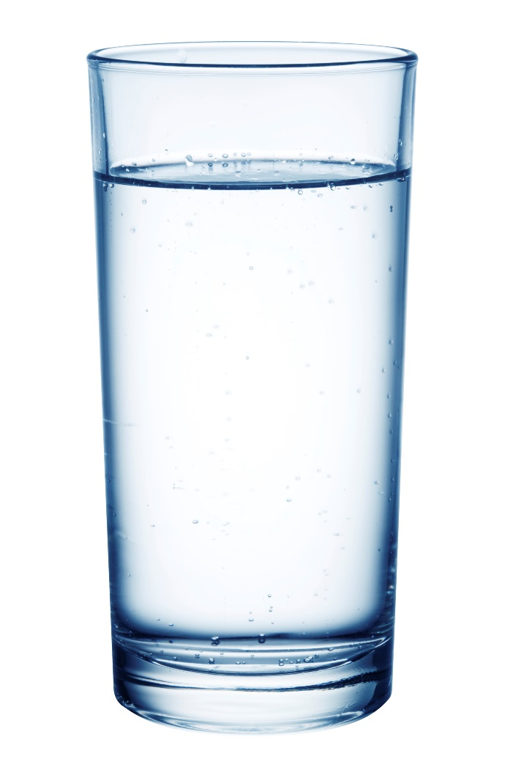
Remember, water is the healthiest source of hydration!
0 teaspoons of sugar
200ml
Notes:
Tap water
Remember, water is the healthiest source of hydration!

Slide 19
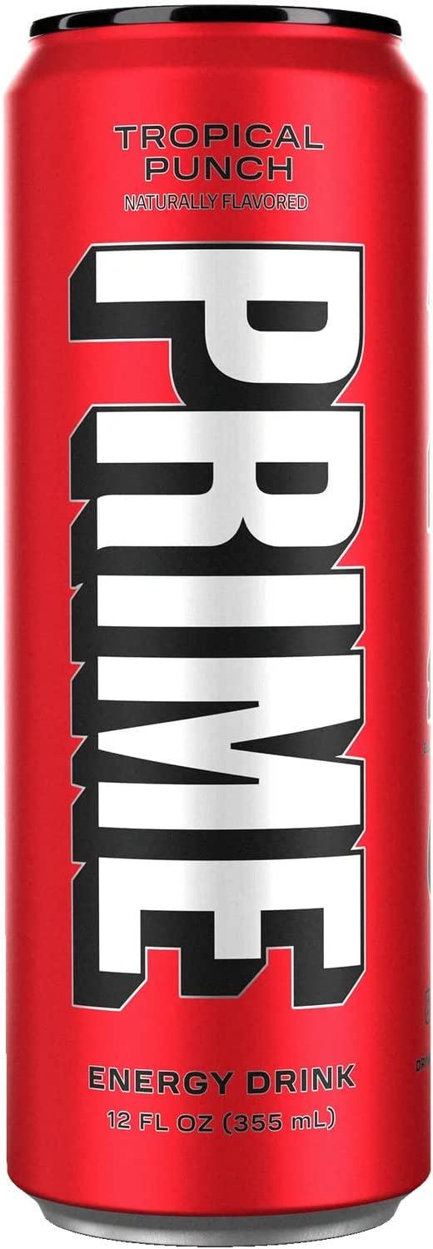
Prime Energy contains no sugar…BUT it contains lots of caffeine, which isn’t good for young children.
0 teaspoons of sugar
355ml
Notes:
Prime Energy Drink – tropical punch
Answer: 0 sugar – but lots of caffeine, which is unsuitable for children

Slide 20
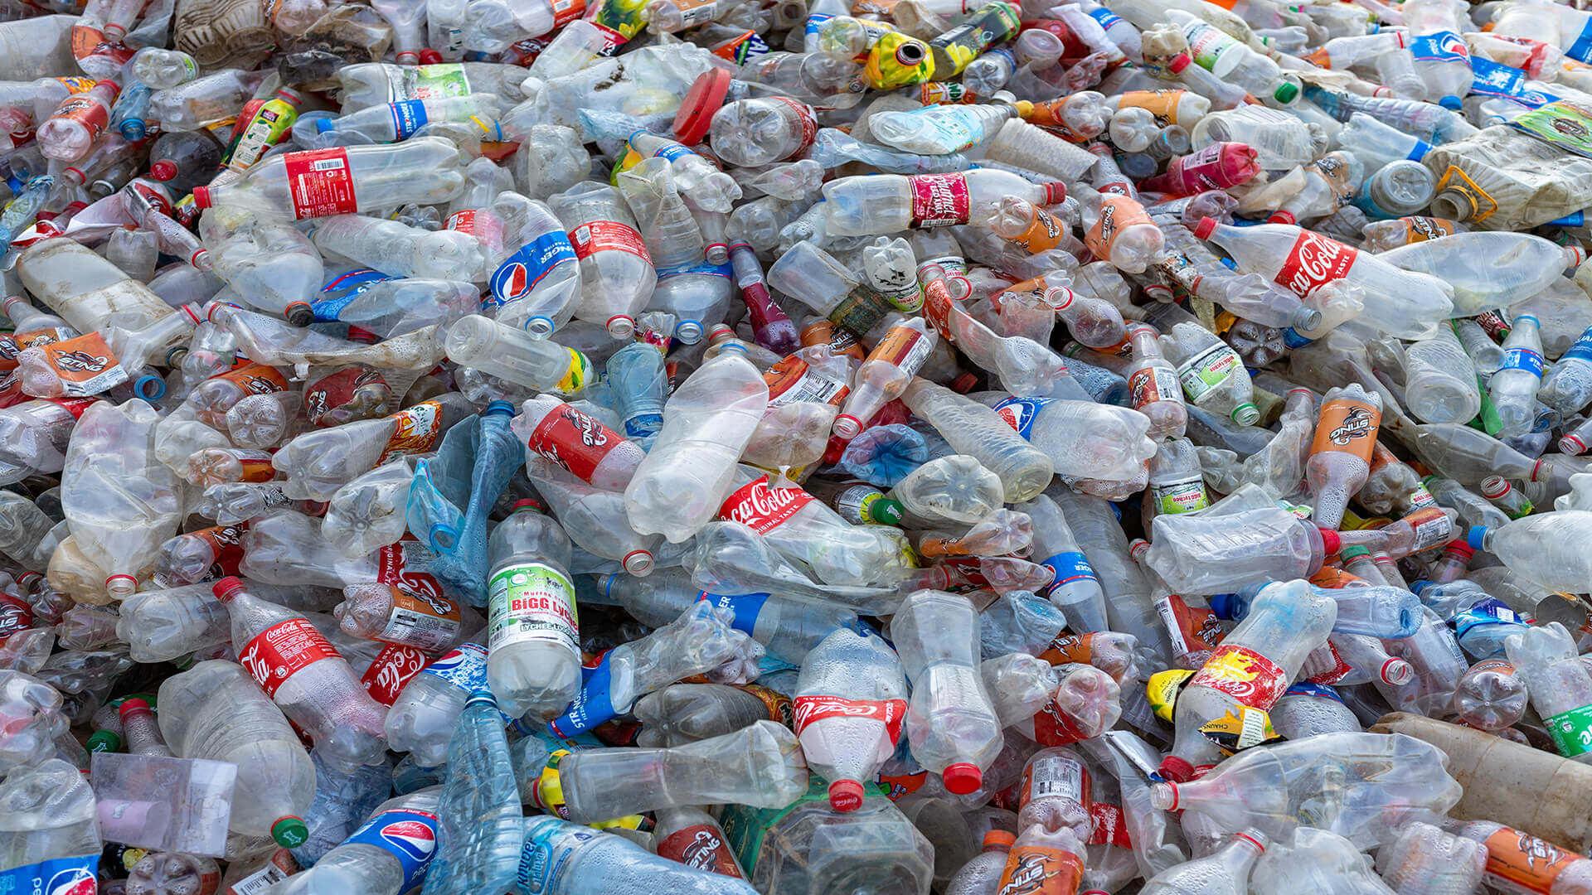
Do bottled sugary drinks harm the planet?
Notes:
Ask children to put their hands up if they think bottled sugary drinks harm the planet?

Slide 21
Notes:
Explain to children that by 2050, there child be more plastic in the oceans than fish. Ask children why they think this will be a problem?

Slide 22
Plastic in the ocean harms sea life
Notes:
Explain to children that plastic bottles can break up into lots of tiny pieces which can be found everywhere – they can even end up in our drinking water!
Sea creatures can become tangled by plastic bags, abandoned fishing gear or discarded six-pack rings.
Starvation occurs when an animal’s stomach is so packed with plastics that it reduces the animal’s urge to eat, causing starvation.
Digestion problems occur when animals eat plastics, such as bottles or bags, cannot be digested or passed by an animal so it stays in the gut.

Slide 23
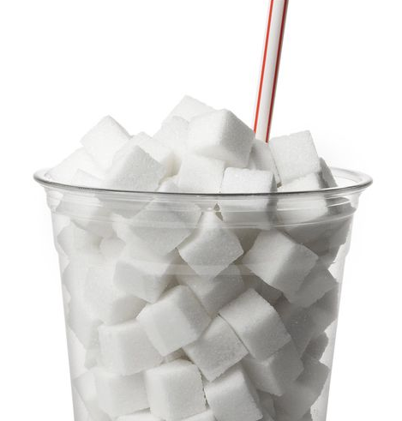
Give Up Loving Pop!
To protect our planet
To protect our teeth
Notes:
An easy way to reduce your sugar intake is to stop or cut down on sugary drinks and to Give Up Loving Pop.
Remember, the maximum amount of sugar for your age group* includes added sugar found in food too.
Give up Loving Pop to protect our planet and our teeth!

Slide 24
What can you do to help?
Carry your GULP water bottle around with you to refill on the go!
If you buy a plastic water bottle, remember to recycle it!
Notes:
An easy way to reduce your sugar intake is to stop or cut down on sugary drinks and to Give Up Loving Pop.
Remember, the maximum amount of sugar for your age group* includes added sugar found in food too.
* 5tsp/ cubes for 4-6 year olds and 6tsp/ cubes for 7-10 year olds.

Slide 25
Who thinks they could Give Up Loving Pop and switch to water and milk?
Some of the benefits:
Healthier teeth
More energy
Better concentration
Water is free
Milk builds strong bones
Notes:
Cutting out sugary drinks is an easy way to reduce how much sugar we eat and drink. Why not see if you can stop drinking sugary drinks for four weeks and see how you feel. You never know you may not even miss them.
There are lots of benefits to drinking water or milk instead (see slide) – ask “can you think of any more?”
Finish with a show of hands “who will Give Up Loving Pop for four weeks and switch to water and milk?”

Slide 26
Thank you for listening!
© Health Equalities Group 2023

