Slide 1
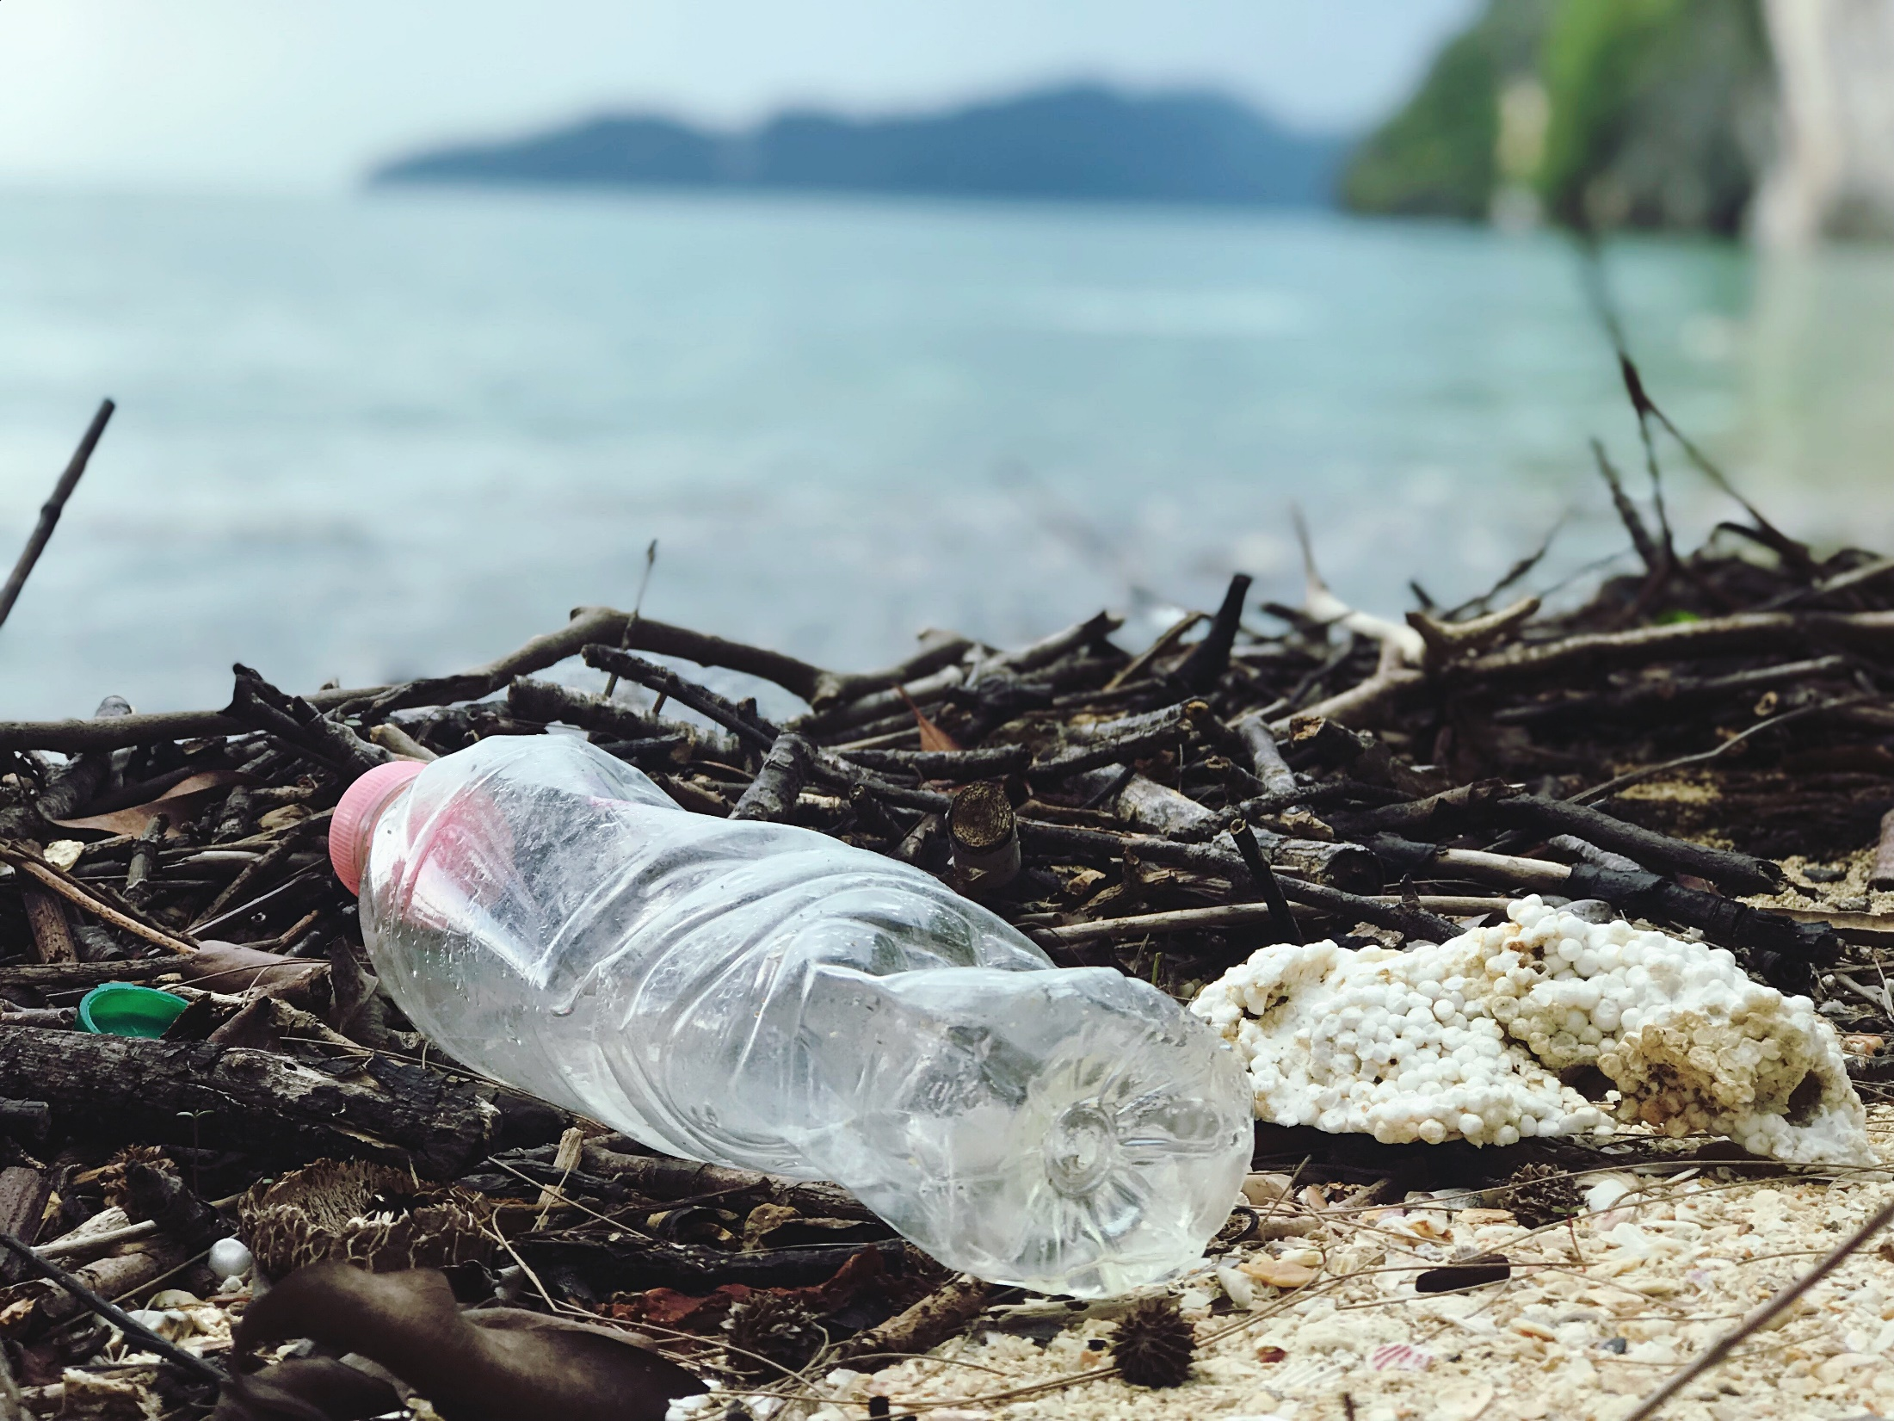

Reduce, Reuse, Refill, Repeat
KS3 ASSEMBLY

Slide 2
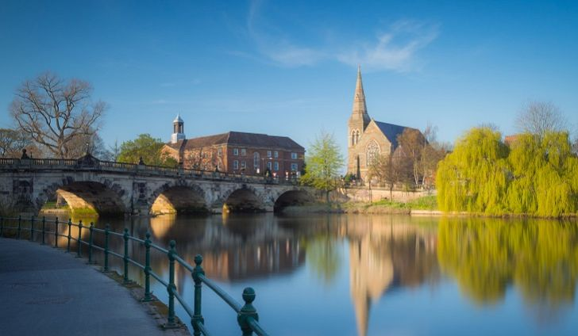
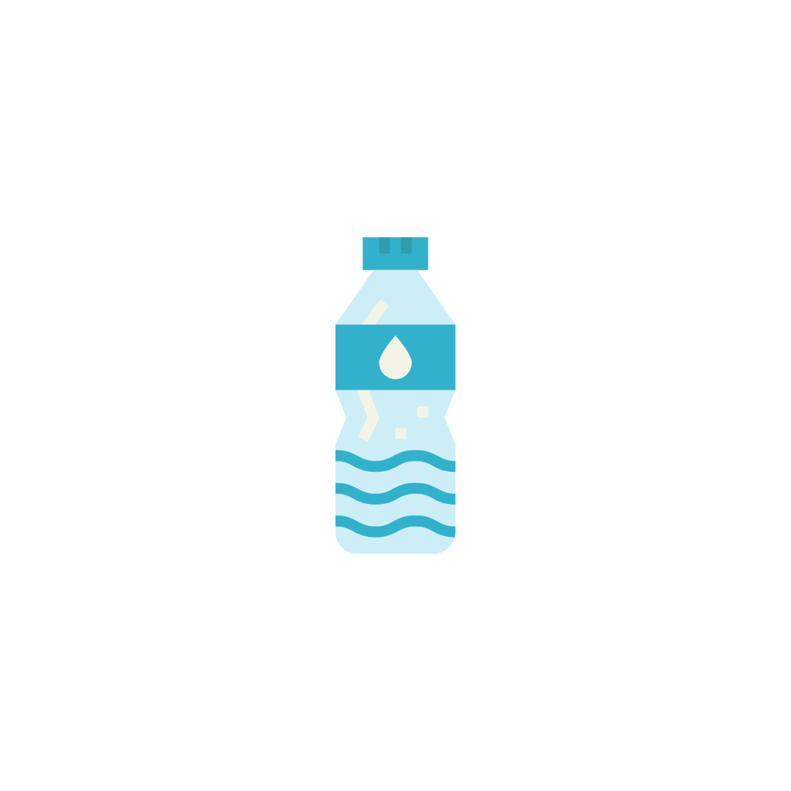
What is the most common plastic item found in UK rivers?
Plastic bottles
Notes:
The most common plastic item found in UK rivers is plastic bottles. Ask the pupils to put their hands up if they buy a plastic bottle every day.

Slide 3
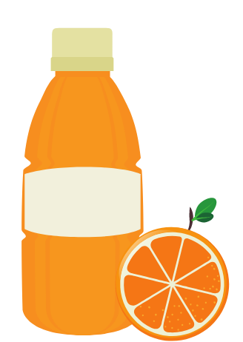
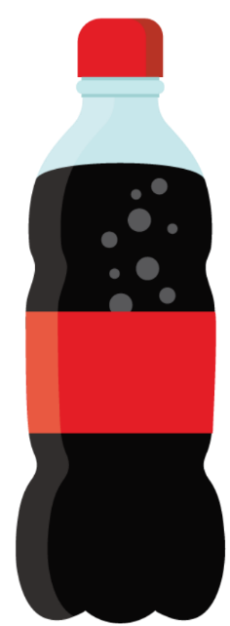
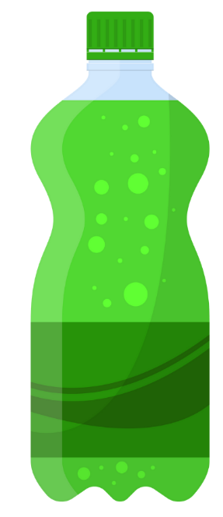
What types of drinks are in plastic bottles?
Fruit juice
Fizzy drinks
Bottled water
Notes:
The most common plastic item found in UK rivers is plastic bottles. Ask the pupils to put their hands up if they buy a plastic bottle every day.

Slide 4
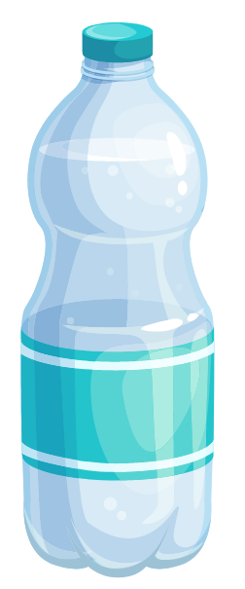
Planet Earth’s plastic bottle problem
Around the world – about 1 million plastic water bottles are bought every minute
If we don’t act soon, this number is set to increase by another 20% by 2023
Notes:
Talk through the bullet points on the slide to provide some context on just how many plastic bottles are used a globally every year.

Slide 5
What is climate change?
Climate change refers to changes in the Earth’s average temperature
These changes occur naturally overtime, but most scientists think that human behaviour is increasing the amount of greenhouse gases in the atmosphere, which is causing more rapid changes
Greenhouse gases, such as carbon dioxide and methane absorb and release heat energy, causing the Earth’s atmosphere to warm up.
Notes:
Source: https://www.un.org/sites/un2.un.org/files/fastfacts-what-is-climate-change.pdf
Read through the bullet points one by one.

Slide 6
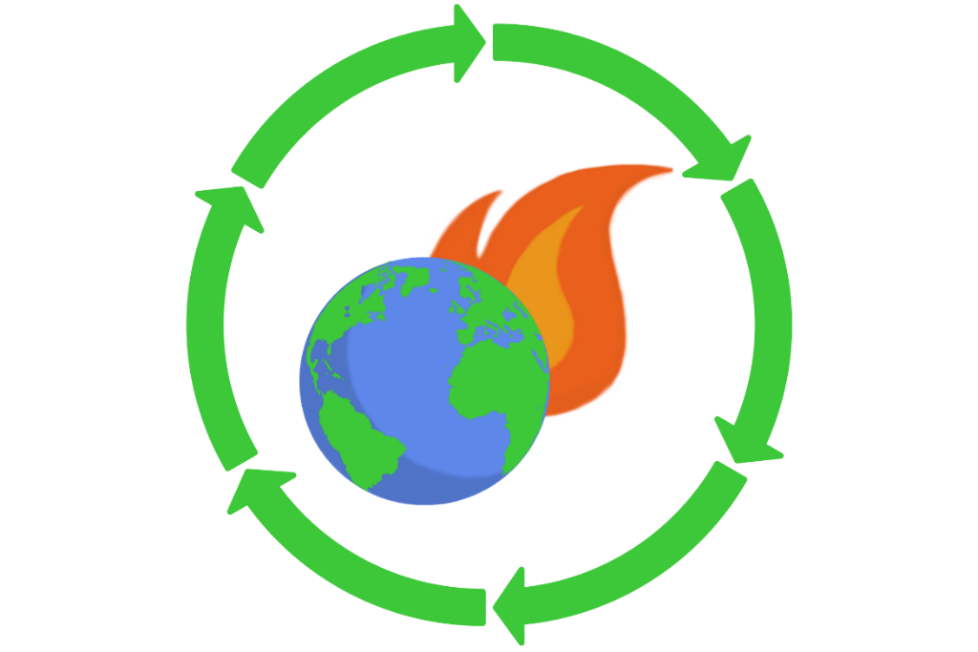
Plastic Bottles and Climate Change
Greenhouse gases can be caused by burning fossil fuels, transport, agriculture and food waste.
Plastic bottles contribute significantly to global greenhouse gas emissions and climate change.
Can anyone guess how?
Notes:
Ask the pupils to think about the lifecycle of a plastic bottle – from it’s production to ending up on our supermarket shelves. Then ask how they think plastic bottles impact upon climate change.

Slide 7




The Energy Demands of a Plastic Bottle
PET is made from crude oil and natural gas – and accounts for 10% of the globes annual oil usage!
The production of the bottle itself requires a huge amount of resources, including energy, water & more
Bottled water requires 2,000x more energy than tap water!
How do we like to drink our bottled drinks? Ice cold! Bottles are stored in refrigerators both at home and in the shops which also needs lots of energy!
The bottles are then shipped across the globe to be filled with drinks – by ship, plane and road – which requires lots of energy
Notes:
Read through section by section, the lifecycle and energy demands of a humble plastic bottle.
Ask the pupils whether they can remember what PET stands for and who is was created by – the answer is polyethylene terephthalate and Nathaniel Wyeth.

Slide 8
But what happens when we are finished with them?
Notes:
Ask the pupils to think about what happens to plastic bottles when we have finished with them. Answers may include in the bin, recycled, reuse, littered

Slide 9
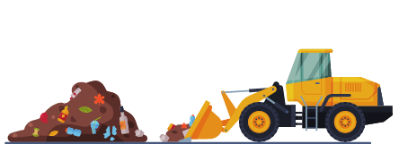

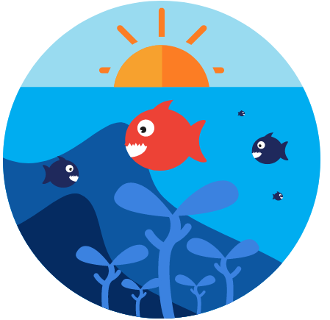

Where do they end up?
Landfill
Rivers
Did you know?
Only 44% of bottles are recycled in the UK
Oceans
Recycled
Notes:
Read through the different examples of where plastic bottles typically end up on our planet. Landfill, oceans, rivers, recycled

Slide 10
How do plastic bottles reach our rivers and oceans?
Plastic put in the bin ends up in landfill. On its way, because plastic is so light, rubbish is often blown away.
Littering – litter doesn’t stay on the street, rainwater and wind carries it into streams and rivers, where it goes down drains, which end up in the ocean.
It is estimated that 700,000 plastic bottles
are littered every day in the UK – the equivalent of around 15 garbage trucks worth!
Notes:
Before revealing the bullet points, ask the pupils how they think plastic bottles end up in our rivers and oceans.
Reveal the bullet points one by one. Ask the pupils if they ever see plastic bottles littered on their journey to school or near home.

Slide 11
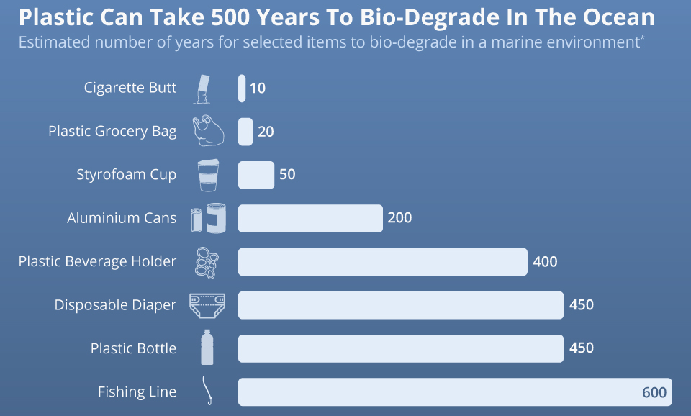
How long do plastic bottles stay in the ocean for?
A plastic bottle which ended up in the ocean in 1570 – when Queen Elizabeth I was queen would only have decomposed now!
Notes:
Ask the pupils whether they can guess how long it takes for a plastic bottle to biodegrade in the oceans. Reveal the table – the answer is 450. Explain that if plastic bottles were disposed into the ocean in 1570, they would only be decomposed now – all the way back during Queen Elizabeth the first’s reign!
Explain that plastics can survive for hundreds of years as it is not biodegradable and hard to decompose. This varies between the type of plastic, and plastic bottles take the second longest time to bio-degrade – which is up to 450 years. Ask the pupils whether anything surprises them here and whether they think this is a long time.

Slide 12
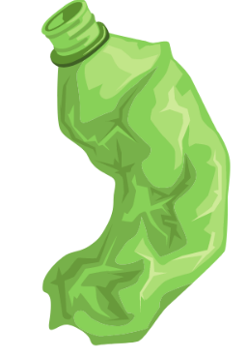
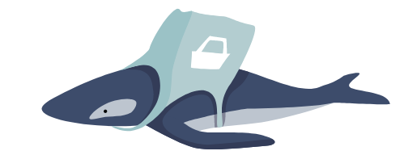

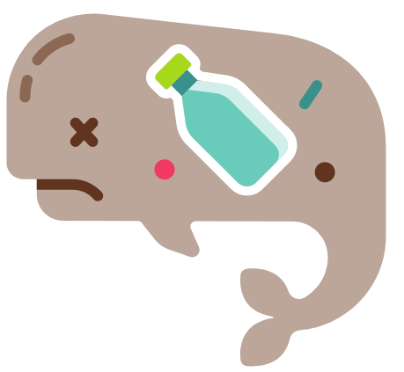
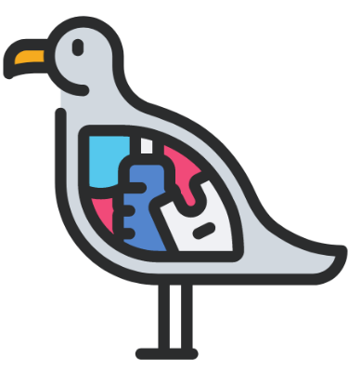
Where do they end up?
Microplastics
Entanglement
Starvation
Digestion problems
Notes:
Talk through the various ways plastic pollution is a problem with the students one by one;
Microplastics are plastic bottles and other types of plastic broken down into very small pieces, which have now been found in every corner of the globe and have found their way into our drinking water and food chain which could be harmful to our health.
Entanglement affects seals, whales, turtles, and other animals are strangled by abandoned fishing gear or discarded six-pack rings.
Starvation occurs as when an animals stomachs are so packed with plastics reduce the urge to eat, causing starvation.
Digestion problems occur when animals eat plastics, such as bottles or bags, cannot be digested or passed by an animal so it stays in the gut.

Slide 13
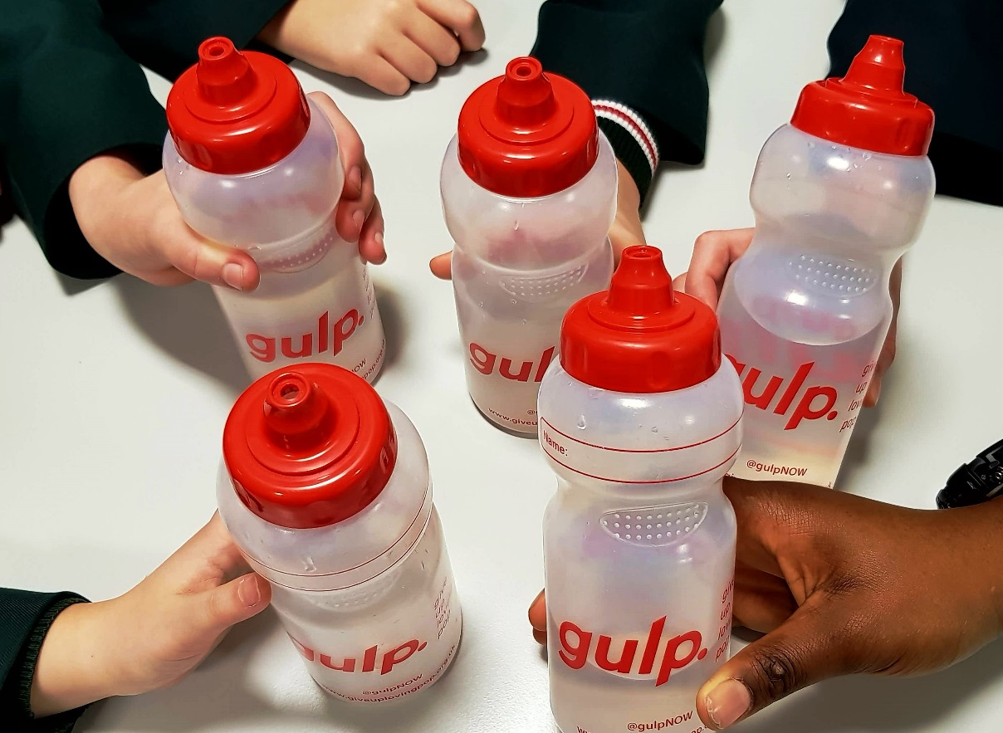
How many plastic bottles could you save if you carried your reusable GULP bottle with you every day?
1,460!
Notes:
You can also mention that you can save a lot of money over the year by swapping from a regularly buying bottled drinks for a reusable water bottle.

Slide 14
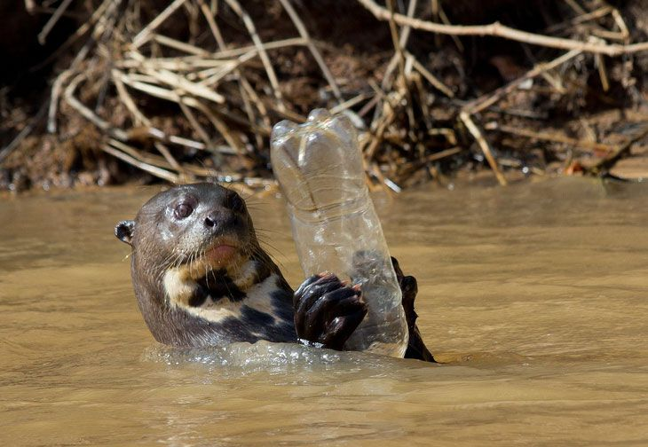
The effect on marine life
Notes:
Ask the students what they see and whether this shocks them.

Slide 15
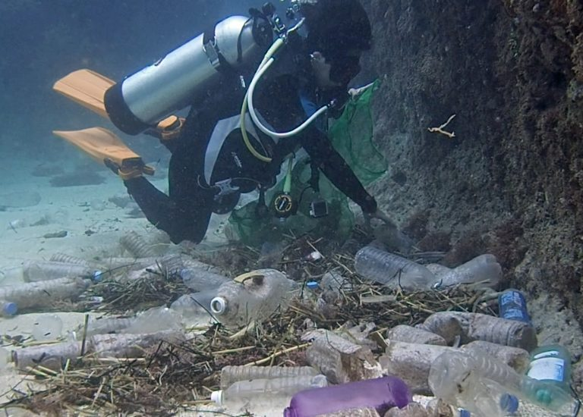
The effect on marine life
44% of all seabirds have eaten plastic
One marine mammal or sea bird dies every 30 seconds due to plastic pollution
By 2050, there could be more plastic in the ocean than fish!
Notes:
Ask the students what they see and whether this shocks them.

Slide 16
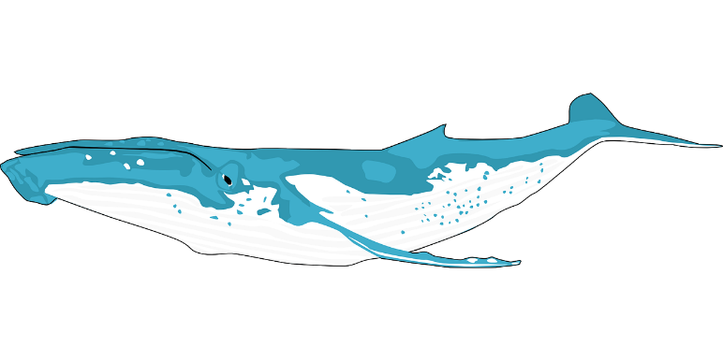
It’s time to #GiveUpLovingPop!
In the UK we buy 35 MILLION plastic bottles every day - the same weight as 12 Blue Whales (the largest animal ever to have existed!)
Many of these drinks can be high in sugar
Whilst opting for bottled water is a great move for your health, it may not be such a good move for the environment.
Notes:
It’s time to GULP. Read through the bullet points on the slide one by one.
Remind students how many said they buy a plastic bottle every day, and this is contributing to the 35 million figure which equates to the weight as 12 blue whales.

Slide 17
So…what can we do to help?
REDUCE!
STOP buying plastic bottles – an easy way to do this is to stop drinking sugary drinks and bottled drinks. Less is more!
REBEL!
But remember, only 44% of plastic bottles get recycled, and require a huge amount of energy to produce.. So reduce and refill where you can!
Rebel against the companies who are destroying our planet and join the refill revolution!
REFILL!
Carry your reusable GULP bottle around with you to refill on the go!
RECYCLE!
If you do buy a plastic bottle (or any plastics for that matter), make sure you recycle it by checking the labelling for the recycling instructions.
Notes:
Before revealing the text, ask the pupils what they can do to help tackle some of the issues covered in today’s session. Explain there are 3 simple R’s that we can do to help reduce the impact of plastic bottles on our environment.
Firstly, we can reduce our use of plastic bottles but stopping buying sugary and bottled drinks.

Slide 18
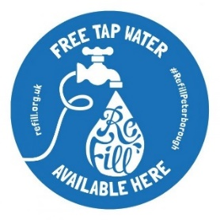
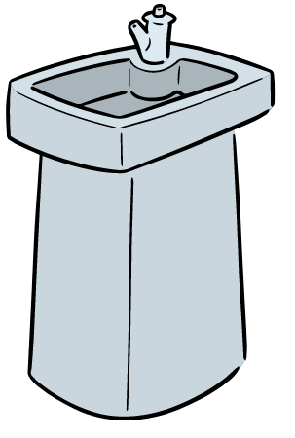

Where can you refill your GULP water bottle?
You can usually find water stations in most public places, train stations, hospitals, schools, waiting areas etc.
You can also go into any cafe or restaurant and ask a member of staff to fill up your water bottle.
Notes:
Go through the bullet points in the slide as to where you can refill your water bottle. Ask the pupils if there is anywhere missing and who currently carries round a water bottle with them, and where they usually fill it up.
Look out for water fountains when you are out and about – where can you find one?

Slide 19
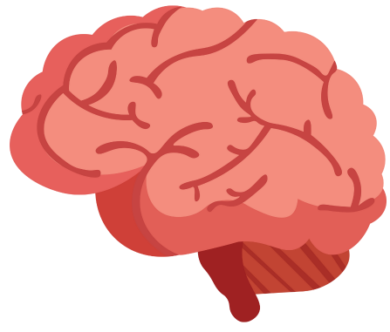
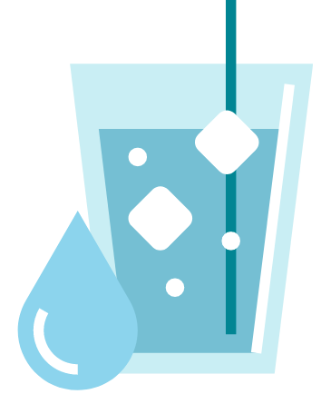
Water is a superpower!
Water is ESSENTIAL for life and we need to drink around 6-8 glasses every day
Our brain is made up of 73% water, so lack of hydration can have a serious effect on how our brains function
Water carries nutrients and waste products between our major organs
Water regulates our body temperature
Notes:
Ask the pupils why they need to drink water – what are the benefits to our health (before revealing the bullet points)
Read through the notes on the slide, stressing the importance of keeping hydrated. Throughout the day we lose a lot of water, can anyone tell me how? (prompt for answers such as through sweat, urine, illness). Emphasise that it is important therefore to make sure we drink plenty of water – and refilling our water bottles is a great way to achieve this.

Slide 20
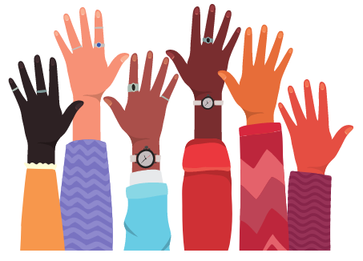
Hands up…
Who wants to keep our oceans, rivers and beaches clean?
Who wants to keep our wonderful sea life safe and happy?
Who wants to #GiveUpLovingPop?
Notes:
Read through the notes on the slide, stressing the importance of drinking lots of water each day. Throughout the day we lose a lot of water, can anyone tell me how? (prompt for answers such as through sweat, urine, illness). Emphasise that it is important therefore to make sure we drink plenty of water – and refilling our water bottles is a great way to do this.

Slide 21
@gulpNOW
www.giveuplovingpop.org.uk
© Health Equalities Group 2022

