Slide 1
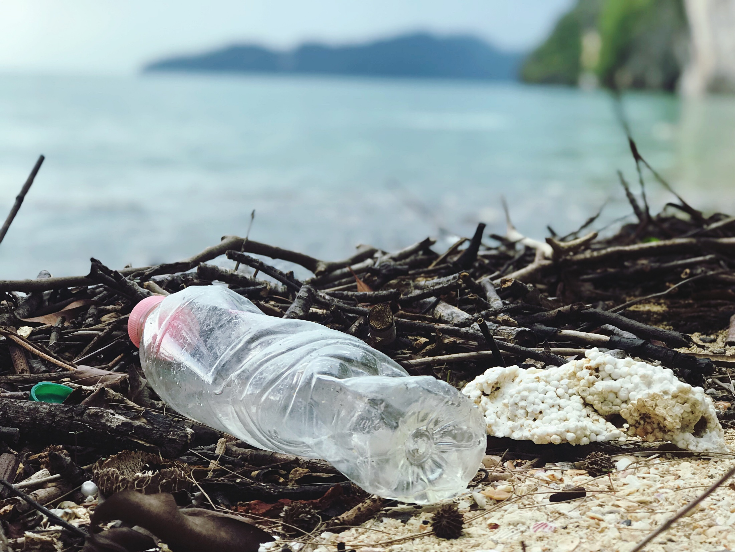
Reduce, Reuse, Refill, Repeat
KS2 ASSEMBLY

Slide 2
What types of things are made from plastic?
Bags
Straws and cutlery
Food packaging
Bottles
Notes:
Explain to the pupils that we are going to be talking about plastic pollution today, focussing on plastic bottles. Ask the pupils to name things that are made from plastic, like bags, bottles, straws and cutlery, food packaging etc. Explain that lots of things are made from plastic.

Slide 3
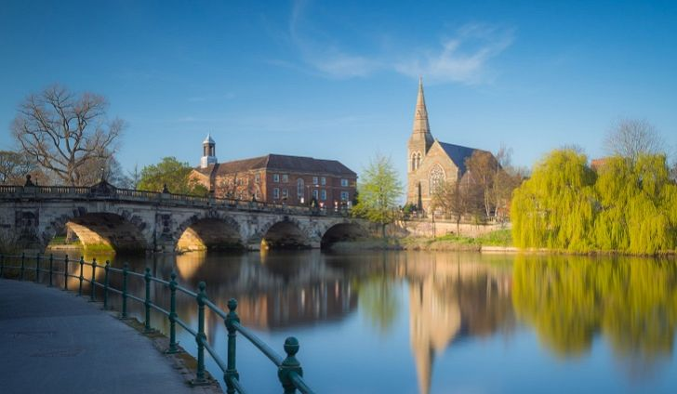
What is the most common plastic item found in rivers?
Plastic bottles
Notes:
Ask children to think about the plastic items we looked at before – bags, bottles, straws and food packaging. Ask them what they think is the most common plastic item found in rivers? The most common plastic item found in UK rivers is plastic bottles. Ask them if they have ever seen plastic bottles or other types of plastic in rivers or at the beach.

Slide 4
What types of drinks are in plastic bottles?
Fruit juice
Fizzy drinks
Bottled water
Notes:
Ask the pupils to name some drinks that come in plastic bottles e.g. fruit juices, water, fizzy drinks.

Slide 5
Planet Earth’s plastic bottle problem
Around the world – about 1 million plastic water bottles are bought every minute!
x 1,000,000!
Notes:
Around the word, 1 million plastic bottles are bought every minute! Ask pupils if that sounds like a lot.

Slide 6
But what happens when we are finished with them?
Notes:
Ask the pupils to think about what happens to plastic bottles when we have finished with them. Answers may include in the bin, recycled, reuse, littered.

Slide 7
Where do they end up?
Landfill
Rivers
Oceans
Recycled
Notes:
Read through the different examples of where plastic bottles typically end up on our planet. Landfill, oceans, rivers, recycled. Explain that only some bottles get recycled. Ask pupils if they know what recycling means. If not, explain that recycling is saving things that were going to be thrown in the bin, to be used again or as something else.

Slide 8
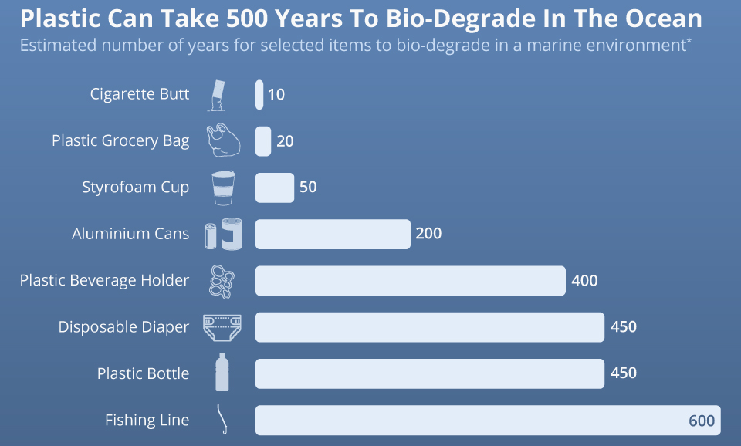
How long do plastic bottles stay in the ocean for?
A plastic bottle which ends up in the ocean now, will still be around by the year 2500!
Notes:
Ask the pupils whether they can guess how long it takes for a plastic bottle to biodegrade in the oceans. Reveal the table – the answer is 450 years. Explain that if plastic bottles were disposed into the ocean now, it would still be around by 2500 - that’s 450 years away!
Explain that plastics can survive for hundreds of years as it is not biodegradable and hard to decompose. This varies between the type of plastic, and plastic bottles take the second longest time to bio-degrade – which is up to 450 years. Ask the pupils whether anything surprises them here and whether they think this is a long time.

Slide 9
How does plastic harm sea life?
Notes:
Ask children how plastic can harm sea life.
Plastic bottles can break up into lots of tiny pieces which can be found everywhere – they can even end up in our drinking water!
Sea creatures can become tangled by plastic bags, abandoned fishing gear or discarded six-pack rings.
Starvation occurs when an animals stomach is so packed with plastics that it reduces the animal’s urge to eat, causing starvation.
Digestion problems occur when animals eat plastics, such as bottles or bags, cannot be digested or passed by an animal so it stays in the gut.

Slide 10
So…what can we do to help?
REDUCE!
STOP buying plastic bottles – an easy way to do this is to stop drinking sugary drinks and bottled drinks.
Carry your reusable GULP bottle around with you to refill on the go!
REFILL!
RECYCLE!
If you do buy a plastic bottle, make sure you recycle it!
Notes:
Before revealing the text, ask the pupils what they can do to help tackle some of the issues covered in today’s session. Explain there are 3 simple R’s that we can do to help reduce the impact of plastic bottles on our environment.
Firstly, we can reduce our use of plastic bottles but stopping buying sugary and bottled drinks.
We can carry our reusable GULP bottles around with is so we can refill on the go.
If we do have to buy a plastic bottle, we can make sure to recycle it.

Slide 11
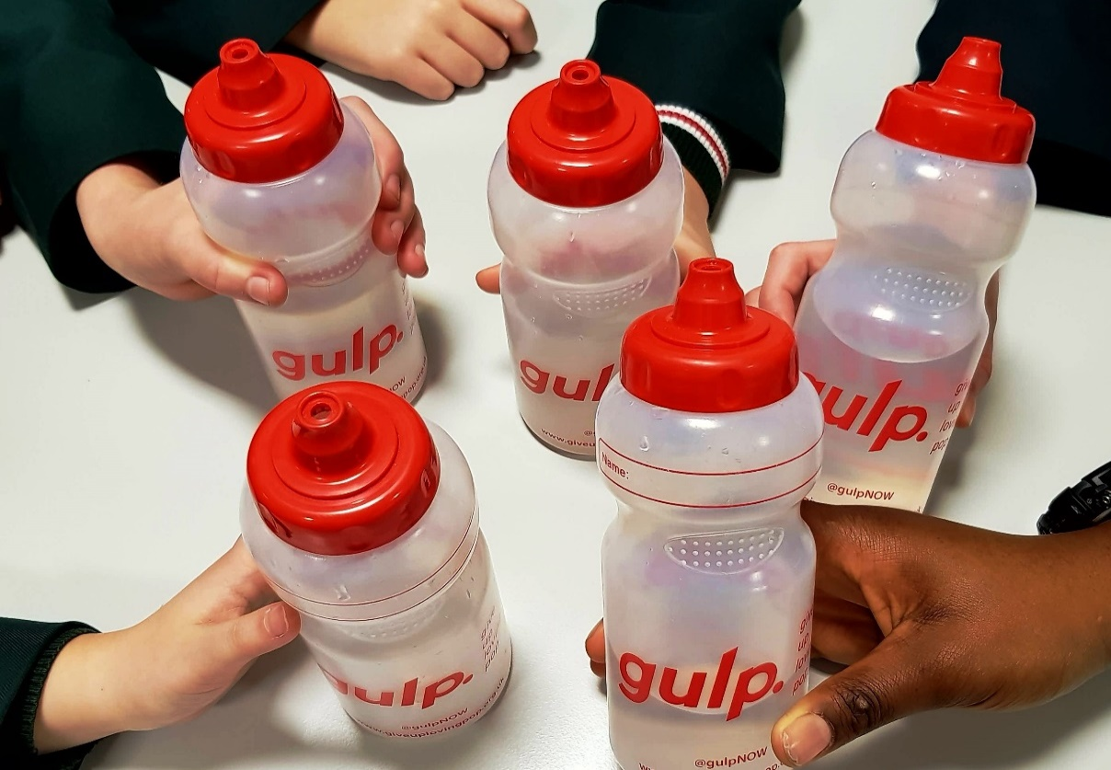
How many plastic bottles could you save if you carried your reusable GULP bottle with you every day?
1,460!
Notes:
Ask pupils to guess how many plastic bottles they could save if they carried and used their GULP water bottle every day. Answer – 1,460!

Slide 12
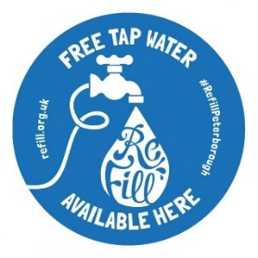
Where can you refill your GULP water bottle?
You can usually find water stations in most public places, train stations, hospitals, schools, waiting areas etc.
Look out for Refill stations!
Notes:
Explain to pupils that you can usually find water stations to refill your water bottle in most pubic places, like schools, train stations, hospitals etc. Ask the pupils if there is anywhere missing and who currently carries round a water bottle with them, and where they usually fill it up.
Look out for water fountains when you are out and about – where can you find one?

Slide 13
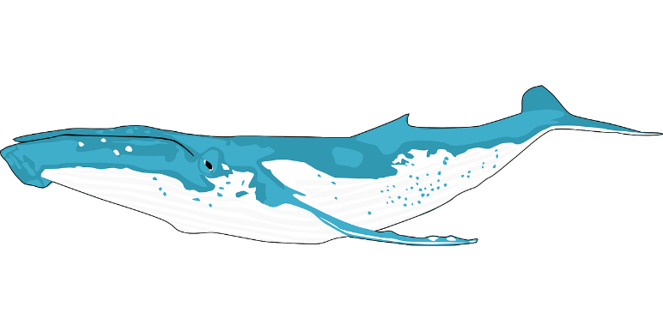
It’s time to #GiveUpLovingPop!
In the UK we buy 35 MILLION plastic bottles every day - the same weight as 12 Blue Whales (the largest animal ever to have existed!)
Many of these drinks can be high in sugar
Whilst opting for bottled water is a great move for your health, it may not be such a good move for the environment.
Notes:
It’s time to GULP. Read through the bullet points on the slide one by one.
Remind students how many said they buy a plastic bottle every day, and that this is contributing to the 35 million figure which equates to the weight as 12 blue whales.

Slide 14
Thirsty for more?
We need to drink lots of water to keep healthy
Our brain is made up of a lot of water, and not drinking enough can make it tricky to learn and work hard at school
So refilling our water bottles is good for our health and for the planet – simples!
Notes:
Read through the notes on the slide, stressing the importance of drinking lots of water each day. Throughout the day we lose a lot of water, can anyone tell me how? (prompt for answers such as through sweat, urine, illness). Emphasise that it is important therefore to make sure we drink plenty of water – and refilling our water bottles is a great way to do this.

Slide 15
Hands up…
Who wants to keep our oceans, rivers and beaches clean?
Who wants to keep our wonderful sea life safe and happy?
Who wants to #GiveUpLovingPop?
Notes:
Read through the notes on the slide, stressing the importance of drinking lots of water each day. Throughout the day we lose a lot of water, can anyone tell me how? (prompt for answers such as through sweat, urine, illness). Emphasise that it is important therefore to make sure we drink plenty of water – and refilling our water bottles is a great way to do this.

Slide 16
@gulpNOW
www.giveuplovingpop.org.uk
© Health Equalities Group 2022

