Slide 1
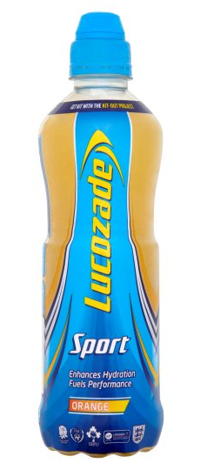
18g
500ml
© Health Equalities Group 2019
Notes:
Lucozade Sport
Sports Drink
~ 4 sugar cubes

Slide 2
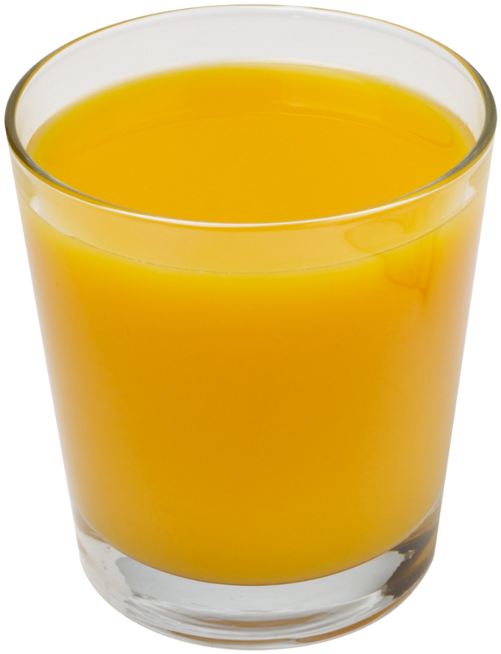
A glass of pure fruit juice counts towards your 5 a day but still contains a lot of sugar. Best to have orange juice during meal times.
21g
200ml
Notes:
Pure orange juice
Fruit Juice
~ 5 sugar cubes

Slide 3
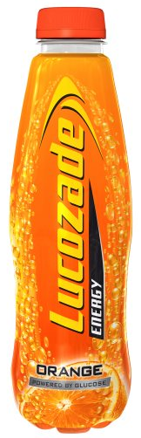
22.5g
500ml
Notes:
Lucozade Energy Orange
Energy Drink
~ 5.5 sugar cubes

Slide 4
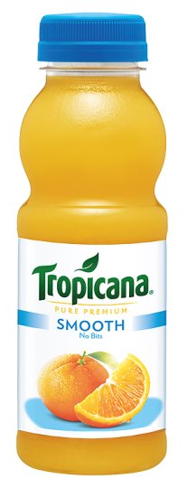
26g
300ml
Notes:
Tropicana Orange Smooth
Fruit Juice
~ 7 sugar cubes

Slide 5
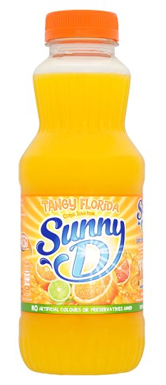
19.2g
500ml
Notes:
Sunny D Tangy Florida
Vegetable Juice
~ 5 sugar cubes

Slide 6
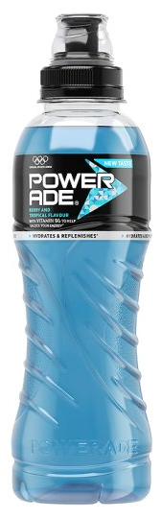
20g
500ml
Notes:
Powerade
Sports Drink
~ 5 sugar cubes

Slide 7
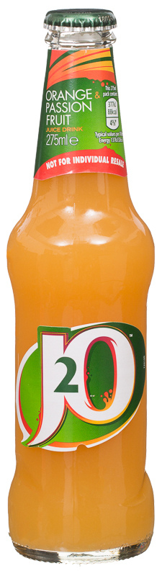
13g
275ml
Notes:
J2O Orange and Passion Fruit
Soft drink
~ 3 sugar cubes

Slide 8
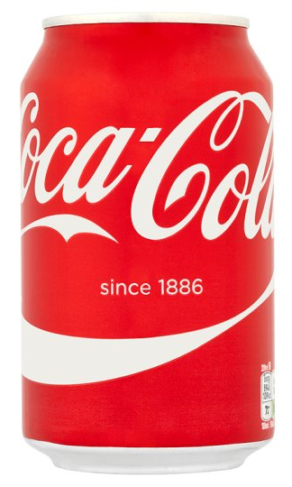
35g
330ml
Notes:
Coca-Cola
Soft drink
~ 9 sugar cubes

Slide 9
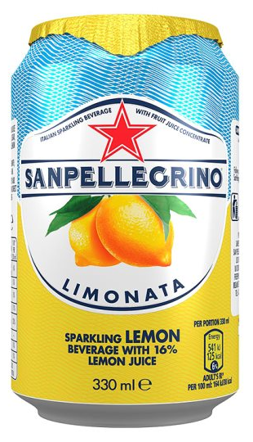
15.5g
330ml
Notes:
San Pellegrino Limonata (Lemonade)
Soft drink
~ 4 sugar cubes

Slide 10
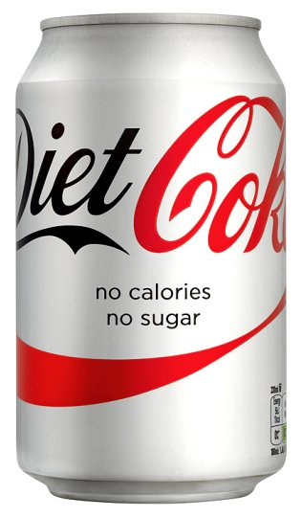
0g
330ml
Notes:
Diet Coke
Diet / Zero Drink

Slide 11
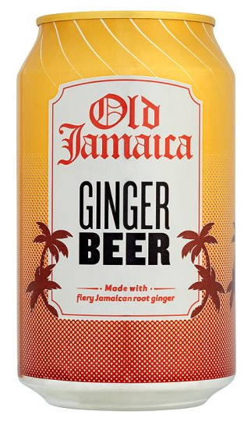
16g
330ml
Notes:
Old Jamaican Ginger Beer
Soft drink
~ 13 sugar cubes

Slide 12
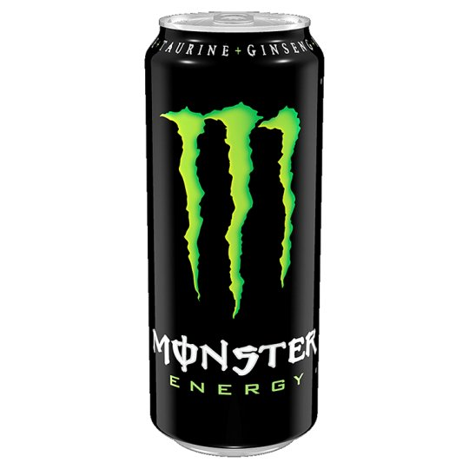
55g
500ml
Notes:
Monster Energy
Energy Drink
~ 14 sugar cubes

Slide 13
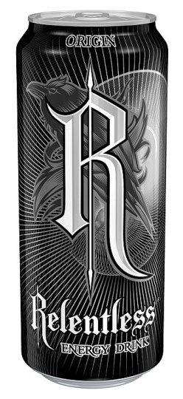
24g
500ml
Notes:
Relentless Origin
Energy Drink
~ 6 sugar cubes

Slide 14
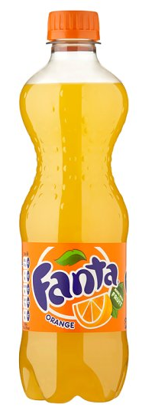
24g
500ml
Notes:
Fanta Orange
Soft drink
~ 6 sugar cubes

Slide 15
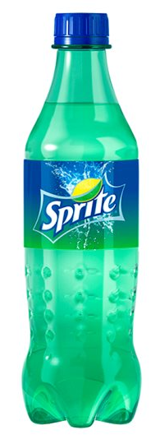
16.5g
500ml
Notes:
Sprite
Soft drink
~ 4 sugar cubes

Slide 16
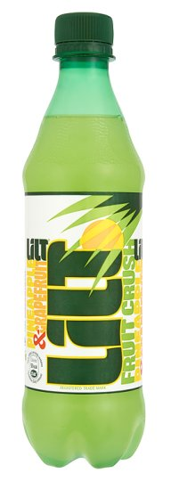
24g
500ml
Notes:
Lilt
Soft drink
6 sugar cubes

Slide 17
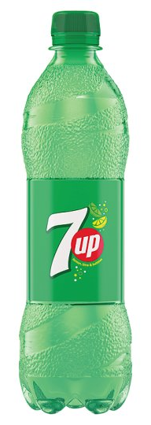
24g
500ml
Notes:
7 UP
Soft drink
6 sugar cubes

Slide 18
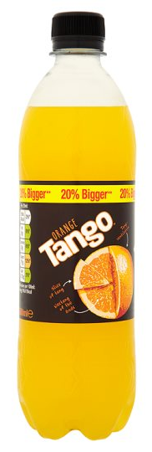
21g
600ml
Notes:
Tango Orange
Soft drink
~ 5 sugar cubes

Slide 19
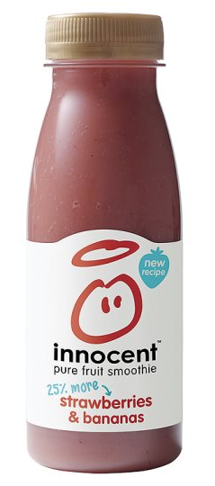
Although they contribute to your 5 a day, smoothies have lots of sugar in them!
26g
250ml
Notes:
Innocent Smoothie Strawberries & Bananas
Smoothie
~ 7 sugar cubes

Slide 20
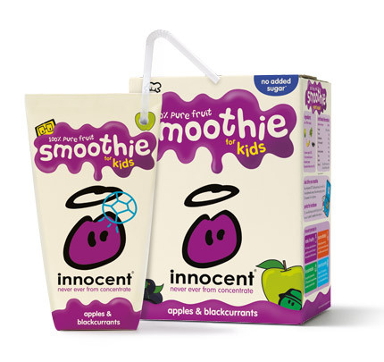
Although they contribute to your 5 a day, smoothies have lots of sugar in them!
18g
180ml
Notes:
Innocent Smoothie Apples and Blackcurrant
Smoothie
~ 5 sugar cubes

Slide 21
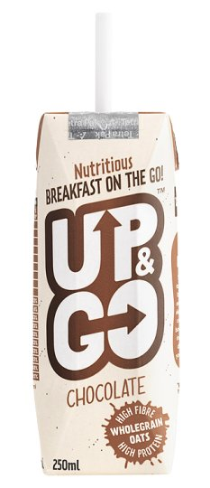
Breakfast drinks contain lots of sugar!
19.5g
250ml
Notes:
Up & Go Chocolate
Breakfast Drink
~ 5 sugar cubes

Slide 22
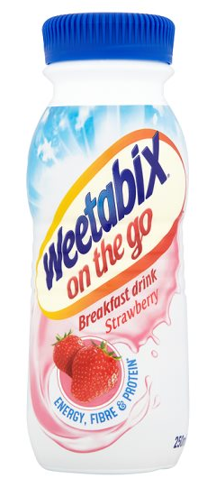
Breakfast drinks contain lots of sugar!
12g
250ml
Notes:
Weetabix on the go Strawberry
Breakfast drink
3 sugar cubes

Slide 23
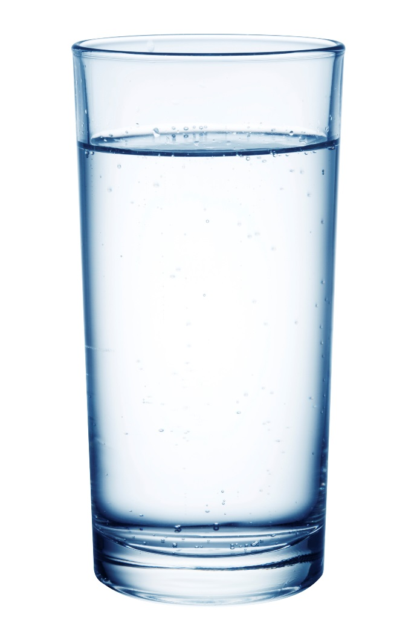
0g
200ml
Notes:
- Tap water

Slide 24
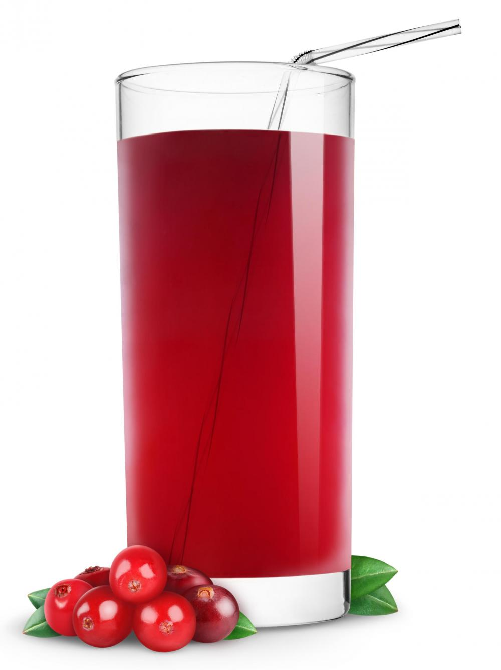
A glass of pure fruit juice counts towards your 5 a day but still contains a lot of sugar. Best to have cranberry juice during meal times.
22g
200ml
Notes:
Cranberry juice
Fruit juice
~ 6 sugar cubes

Slide 25
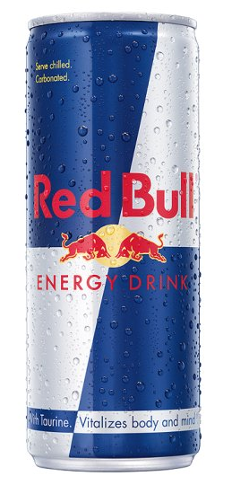
30g
250ml
Notes:
Red Bull
Energy Drink
~ 7 sugar cubes

Slide 26
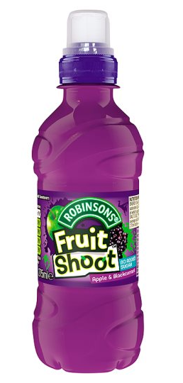
1.6g
200ml
Notes:
Fruit Shoot Blackcurrant & Apple
Fruit juice
Less than half a sugar cube
Product has been reformulated

Slide 27
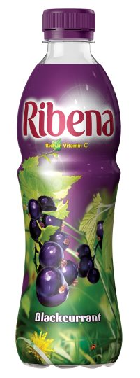
23.2g
500ml
Notes:
Ribena Blackcurrant
Soft drink
~ 6 sugar cubes

Slide 28
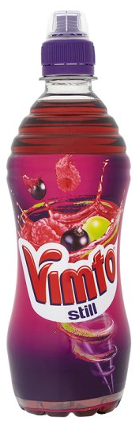
24g
500ml
Notes:
Vimto
Soft drink
~ 6 sugar cubes

Slide 29
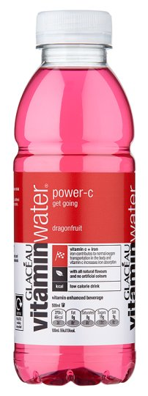
Be wary of flavoured waters, they contain sneaky sugar!
15g
500ml
Notes:
Glaceau Vitamin Water
Flavoured water
~ 4 sugar cubes

Slide 30
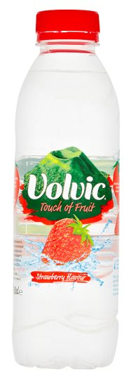
Be wary of flavoured waters, they contain sneaky sugar!
28.5g
500ml
Notes:
Volvic Touch of Fruit Strawberry
Flavoured water
~ 7 sugar cubes

Slide 31
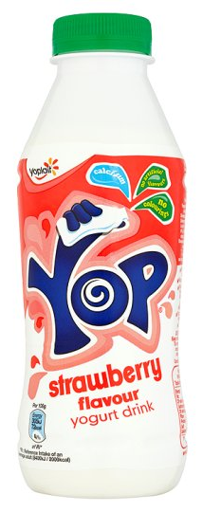
Milkshakes can have a lot of sugar in them!
53g
500ml
Notes:
Yop Strawberry
Milkshake
~ 14 sugar cubes

Slide 32
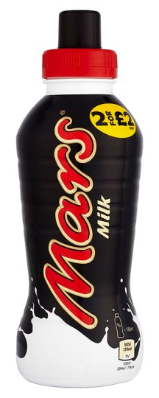
Milkshakes can have a lot of sugar in them!
36g
376ml
Notes:
Mars Milk
Milkshake
12 sugar cubes

Slide 33
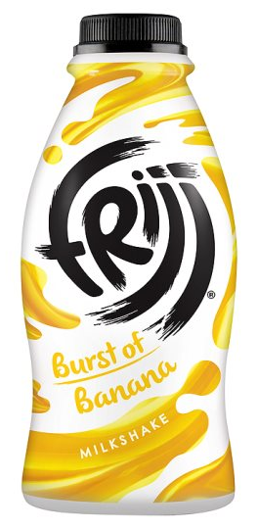
Milkshakes can have a lot of sugar in them!
38.4g
471ml
Notes:
Frijj Burst of Banana
Milkshake
~ 9 sugar cubes

Slide 34
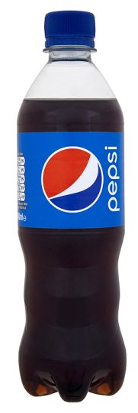
56g
500ml
Notes:
Pepsi
Soft drink
14 sugar cubes

Slide 35
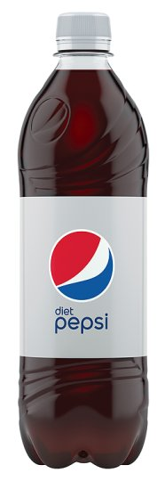
0g
600ml
Notes:
Diet Pepsi
Diet / Zero drink

Slide 36
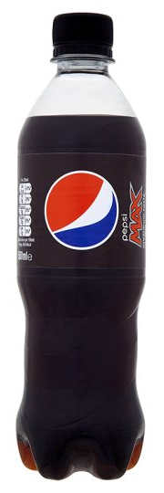
Despite this bottle of Pepsi being called ‘MAX’, it doesn’t actually contain any sugar!
0g
500ml
Notes:
Pepsi Max
Diet / Zero drink

Slide 37
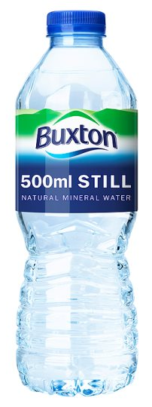
0g
500ml
Notes:
Buxton still
Bottled water

Slide 38
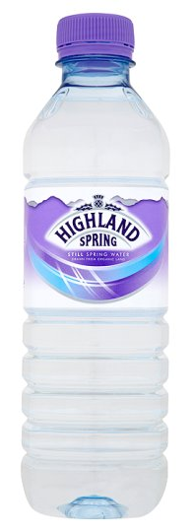
0g
500ml
Notes:
Highland Spring
Bottled water

Slide 39
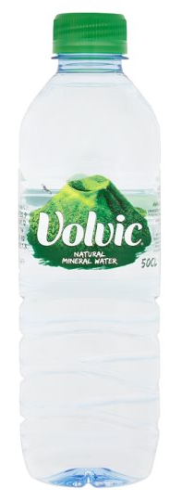
0g
500ml
Notes:
Volvic
Bottled water

Slide 40
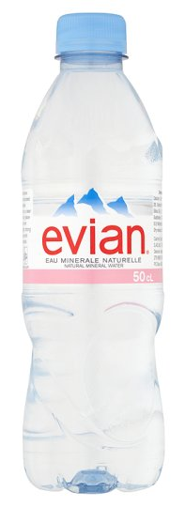
0g
500ml
Notes:
Evian
Bottled water

Slide 41
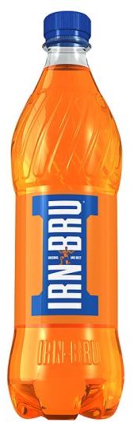
24g
500ml
Notes:
Irn Bru
Soft drink
~ 13 sugar cubes

Slide 42
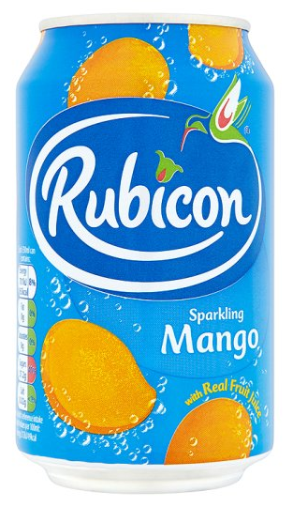
15g
330ml
Notes:
Rubicon Sparkling Mango
Soft drink
~ 9 sugar cubes

Slide 43
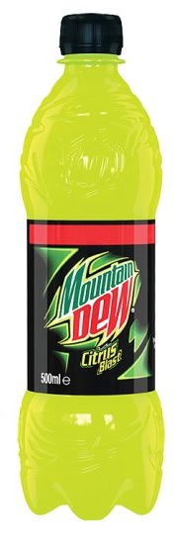
No other sugary soft drink contains as much sugar as Mountain Dew!
66g
500ml
Notes:
Mountain Dew Energy
Energy drink
~ 17 sugar cubes

Slide 44
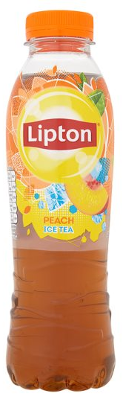
22g
500ml
Notes:
Lipton Ice Tea Peach
Soft drink
~ 6 sugar cubes

Slide 45
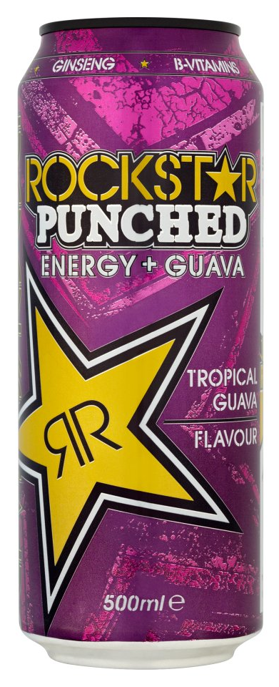
24g
500ml
Notes:
Rockstar Punched Energy + Guava
Energy drink
~ 6 sugar cubes

Slide 46
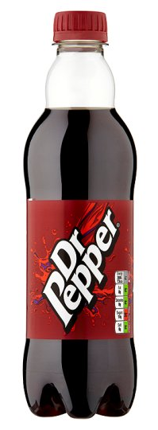
24g
500ml
Notes:
Dr. Pepper
Soft drink
6 sugar cubes

