Slide 1
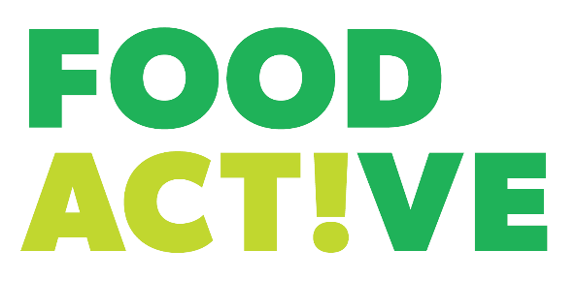

Slide 2
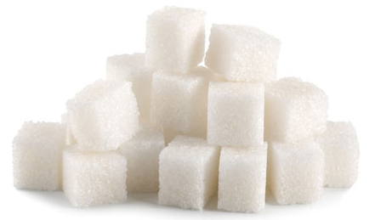
Q: What is the MAXIMUM amount of sugar an average teenager should eat daily?
30g
45g
60g
30g equals 7.5 teaspoons / sugar cubes
Notes:
Ask the students to put their hands up to guess how much sugar they should be consuming from food and drink per day.
The answer is 30g. This is the same for an average adult. Ask the students to remember this figure as they will need it for the next few slides.

Slide 3
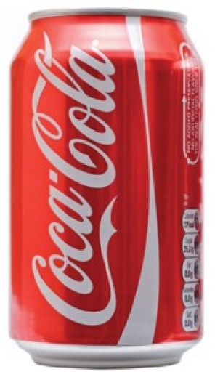
Q: Which drink contains more sugar, a can of
Coca-Cola or a bottle of Juicy Water?
Coca-Cola
Juicy Water
They contain the same amount
35g / 9 teaspoons – that is 120% of maximum amount you should have a day - and this is before you think about the sugar in food!
Notes:
Ask the students which of the two drinks contains the most sugar – the answer is that they contain the same amount, 9 teaspoons, or 36grams.
Ask the students how much sugar they consume as a maximum per day (the answer if 30g). The sugar content of one of these drinks is more than they should be having per day in total.

Slide 4
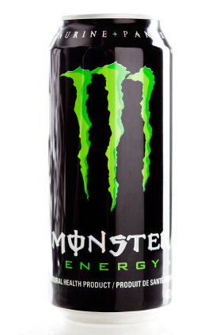
Q: How much sugar is contained in 500ml of Monster?
8 teaspoons (32g)
12 teaspoons (48g)
14 teaspoons (55g)
Accounting for a total of 183% of your
recommended daily amount…
Notes:
Ask the students if they think a can of Monster Energy would contain more or less sugar than a can of Coca-Cola. The answer is more – 14 teaspoons (55g).
Ask the students to remind you how much sugar they should be having per day as a maximum. A can of Monster contains almost twice this amount.
Ask the children whether they like the packaging of this product – very often companies target their products and teenagers by using colours, sports and celebrities they may like. For example, ask the children what is the name of one of the biggest Formula One cards? Answer: Red Bull.
*Note – there are sugar free varieties of Monster available, but these drinks are still high in caffeine.

Slide 5
Q: How much exercise would you need to take to burn off the Monster drink?
41 minute run
47 minutes swimming
101 minutes walking
Any of the above
Notes:
The Monster drink contains 14 teaspoons (55g) of sugar. This equates to 220 calories.
Ask the students how much exercise they would ned to do to use up the calories provided in the Monster drink. The answer is ‘any of the above’.
Ask students “are you surprised by this?”.
When exercising after consuming sugar the body uses the sugar first as energy. The body will only start burning fat once all the sugar has been used.

Slide 6
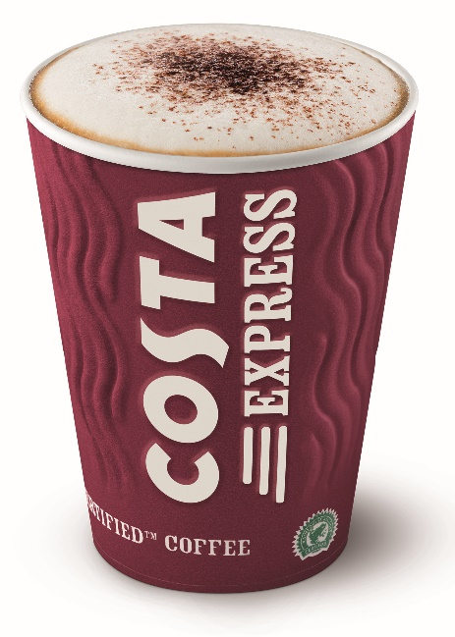
Q: How much sugar is in a ‘Massimo’ Costa Chai Latte?
14 teaspoons (56g)
17 teaspoons (68g)
20 teaspoons (80g)
Accounting for a total of 260% of your
recommended daily amount…
Notes:
This is a shocker!
Some of the younger children may not visit coffee chains, but you could introduce it as a message for them to take home as their care givers may well do.
A Massimo (which is the largest portion size in Costa) Costa Chai Latte was last year reported as containing a whopping 20 teaspoons (80g) of sugar. This is equivalent to the sugar in TEN Krispy Kreme donuts.

Slide 7
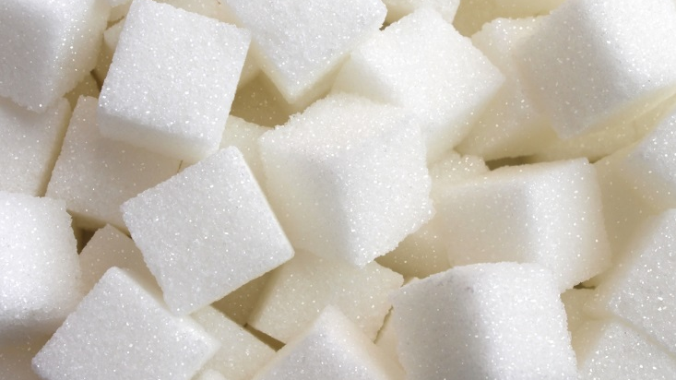
Has anyone noticed any difference in price or flavour of sugary drinks recently?
Notes:
Ask the students whether they have noticed or heard about any changes in the price, size and flavour of sugary drinks recently?
Students may answer: Sugar tax/ Drinks are more expensive / Drinks don’t taste as nice / Drinks have less sugar / Drinks are in smaller cans/bottles now
The sugar tax was introduced in April 2018 as law, which encouraged soft drinks companies to reduce the sugar content of soft drinks otherwise they must pay a tax to continue producing high sugar drinks.
You may have noticed drinks such a Lucozade, Ribena and Rubicon now have up to 50% less sugar than this time last year. This means that there is now much less sugar on our supermarket shelves. However, the likes of Coca Cola, Pepsi and Monster refused to change their recipe, but this now means that they cost more. At this point it might be worth asking whether this would put them off buying them.
Students may answer: Energy drinks / Can’t buy energy drinks in supermarkets
In most leading supermarkets, children under 16 are not allowed to buy energy drinks and will need ID to prove they are of age. This is not law, and corner shops and other off licenses can still sell them to under 16 year olds. This was after a campaign called #NotForChildren which raised concerns about the harmful affects of lots of caffeine and sugar can have on children’s behaviour, concentration and mood both during and after school. The campaign was backed by many teachers who claimed energy drinks were making some pupils hyperactive and disruptive during lessons!

Slide 8
Which group in the UK consumes the most sugar?
Notes:
Ask the students which age group in the UK consume the most sugar. Do they think children do because they may be more likely to eat sweets than adults, or perhaps older people who can often develop a liking for biscuits and cakes?
The answer is on the next slide.

Slide 9
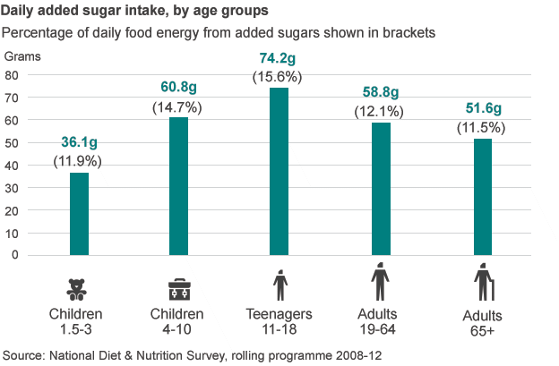
Consumption of sugar in the UK
Notes:
Teenagers on average consume 74.2g of sugar per day. Ask the students if this is surprising. Ask them to remind you how much they should consume as a maximum.
“What do you think makes up the majority of a teenager’s sugar intake? Is it likely to be sweets and chocolate, biscuits and cakes, processed food or sugary drinks? The answer is sugary drinks. 40% of an average teenagers sugar intake comes from sugary drinks.

Slide 10
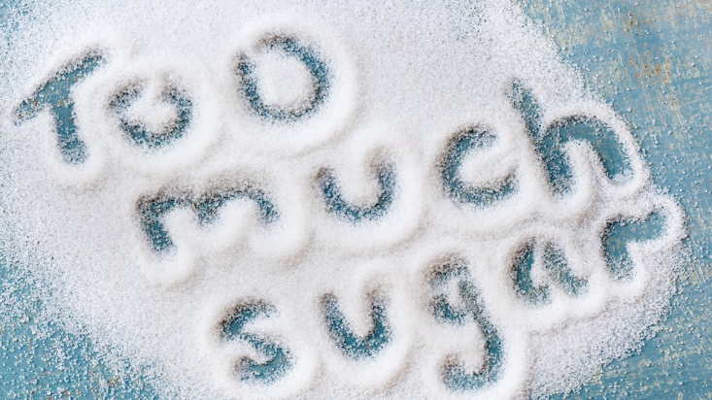
Dental Decay
Obesity
Type 2 Diabetes
Heart Disease
Certain Cancers
Notes:
Ask the children “why do you think there are guidelines limiting the amount of sugar we can all have?”
Ask them “are you aware of any negative health consequences of drinking sugary drinks?”
There is extensive evidence showing the health harms of drinking sugary drinks. These include:
Dental decay
Obesity
Type 2 diabetes
Heart disease
Certain cancers
*Note – these are not always linked to excess calories. Evidence suggest sugary drinks can have metabolic and cardiac issues regardless of weight.
The next few slides will go into more detail.

Slide 11
A major cause of tooth decay is sugary pop; as a result more than one in four 5 year olds experience toothache, fillings and tooth loss

Slide 12
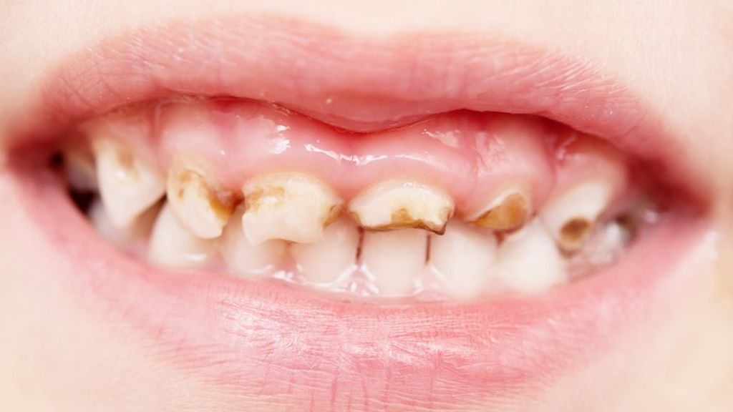
What proportion of eight year olds have
decay in their milk teeth?
Almost Half
What proportion of eight year olds have
decay in their milk teeth?
Notes:
Who has been to the dentist recently?
Has anyone had any problems?
Remind the children that decay doesn’t mean your teeth are falling out but that the dentist needs to look after them.

Slide 13
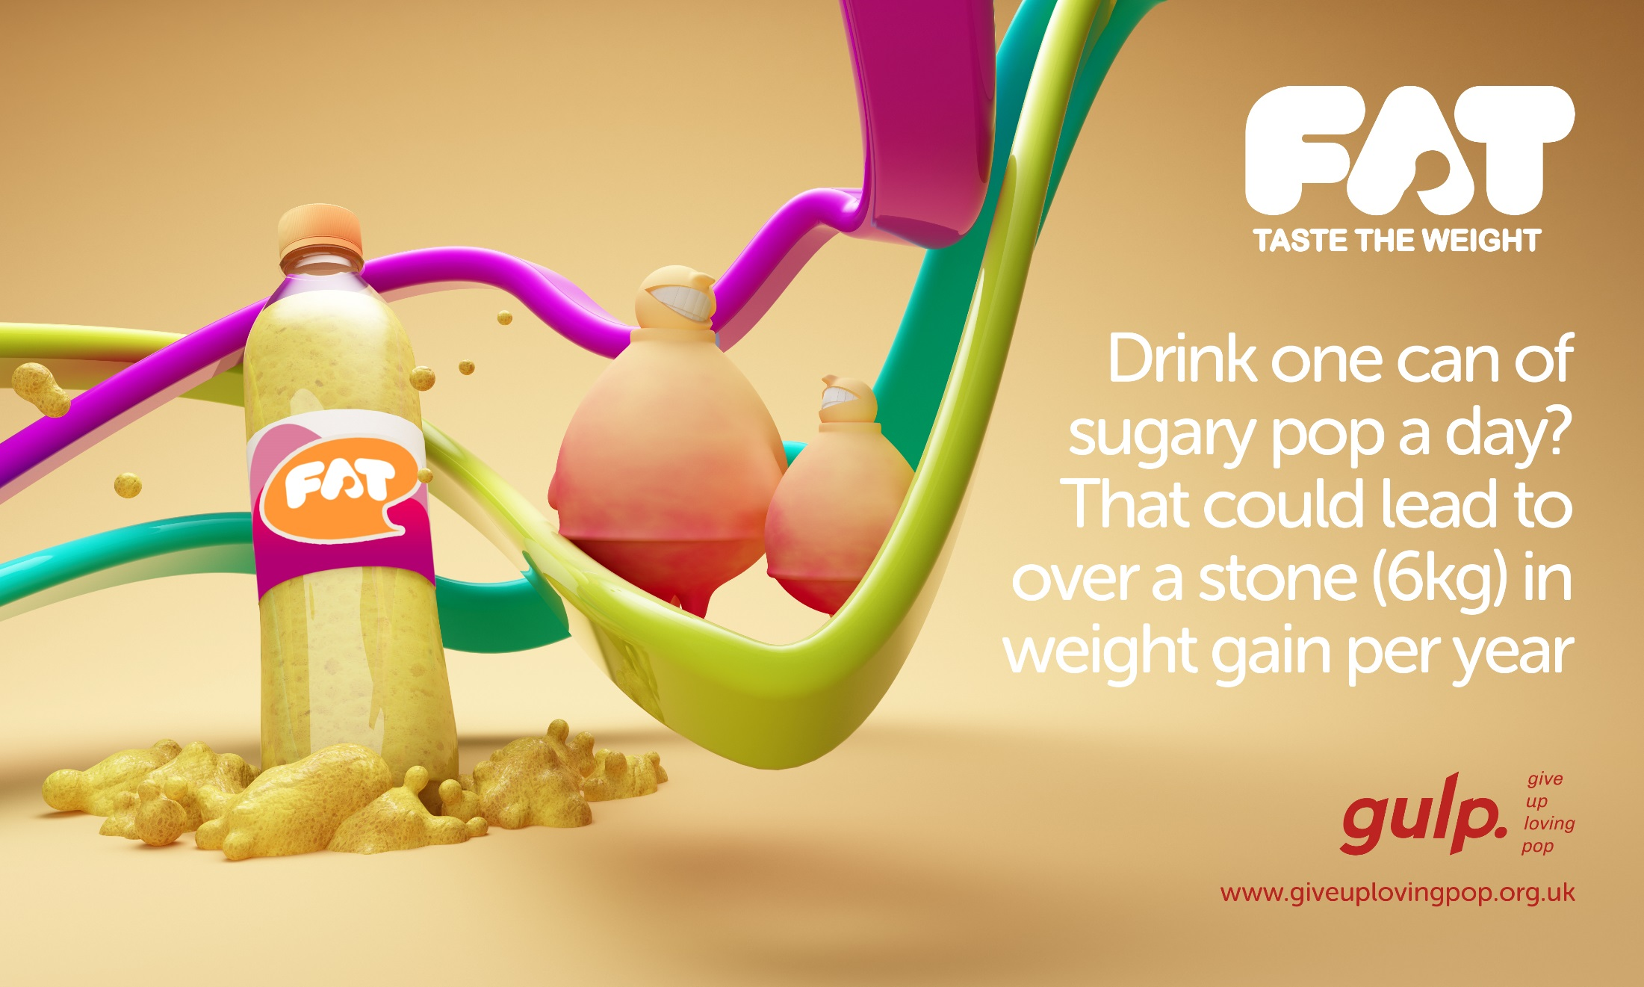
Drinking one
330ml can of pop a
day could lead to
over a stone (6kg)
in weight gain
per year

Slide 14
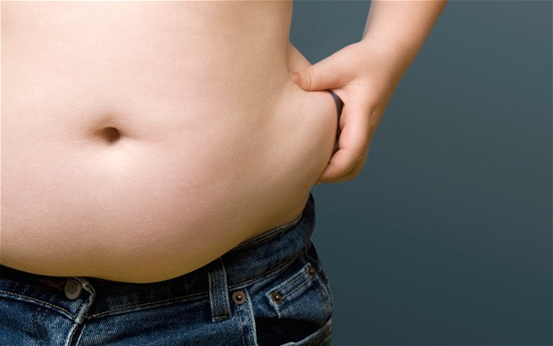
How many children aged 10-11 years old are
overweight or obese?
How many children aged 10-11 years old are
overweight or obese?
1 in 3

Slide 15
Drinking one can
of sugary pop per
day increases your
risk of dying from
heart disease
by a third
Drinking one 330ml can of pop a day could lead to over a stone (6kg) in weight gain per year

Slide 16
How many people will go to hospital today with a heart attack?
How many people will go to hospital today with a heart attack?
515

Slide 17
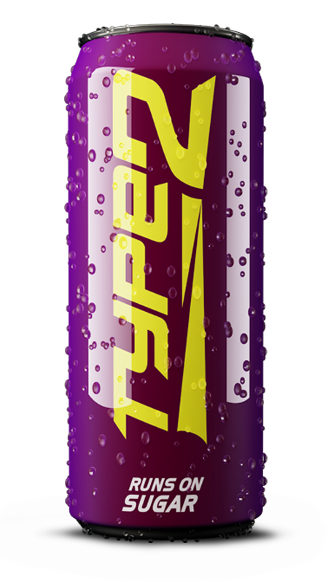
Drinking two cans
of pop per day can
increase your risk
of type 2 diabetes
by more than a
quarter

Slide 18
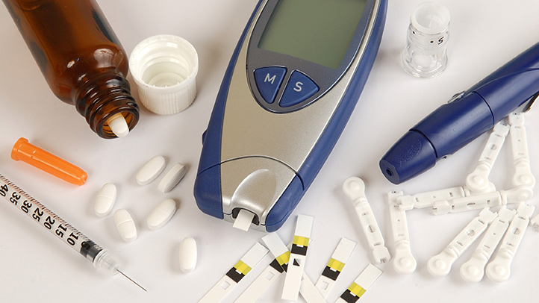
How many people are diagnosed with Type 2 diabetes each day?
How many people are diagnosed with Type 2 diabetes each day?
738

Slide 19
An easy way to reduce sugar intake
Your teeth and waist line will thank you
A great way to save money – water is free!

Slide 20
@gulpNOW #GiveUpLovingPop
www.giveuplovingpop.org.uk

